Slide 1
Governmental Auditing
Update and Issues
Presented By
Bill Blend, CPA, CFE
Daniel J. O’Keefe, CPA, MBA, CFE

Slide 2
Single Audit
The Super Circular

Slide 3
Topics
Overview of Recently Issued Super Circular
Super Circular Updates to Single Audit Requirements
Government Standards for Internal Controls

Slide 4
It’s Here – The Super Circular
OMB - 2CFR Chapter 1 and Chapter II,
Parts 200, 215, 220, 225 and 230
Uniform Administrative Requirements,
Cost Principles, and Audit Requirements for Federal Awards
4

Slide 5
Super Circular Implementation
Time Line
December 26, 2013
December
26, 2014
Beyond
OMB Issued 2 CFR Chapters I, II, Parts 200, 215, 220, 225, & 230
Federal Agencies and OMB to Issue Final Guidance to Non-Federal Agencies
Compliance Supplements
Non-Federal Agencies to Implement New guidance for FYE Beginning on or after December 26, 2014. Florida Govts FYE 2016.
Uniform Administrative Requirements, Cost Principles, and Audit Requirements for Federal Awards
Effective Immediately for All FEDERAL AGENCIES

Slide 6
What Was
Administrative Requirements
Cost Principles
Audit Requirements
A-89
A-102
A-21
A-87
A-122
A-133
A-50
Super Circular
A-110
What Will Be

Slide 7
Policy Reforms

Slide 8
Nine Points of Reform
Elimination of duplicative and conflicting guidance
  Combining 8 previously separate sets of OMB guidance into one (displayed on previous slide). Moving forward federal agencies will implement guidance in unison which should provide non-federal entities with consistent future implementation schedules.

Slide 9
Nine Points of Reform
Focus on Performance over Compliance for Accountability
  Section 200.102 notes that on a case by case basis OMB will waive certain compliance requirements and approve new strategies for innovative program designs.
  Section 200.201 provides for cooperative agreements and fixed amount awards to minimize compliance requirements.
  Section 200.301 provides robust guidance for federal agencies to measure performance.
  Sections 200.419 and 200.430 provides specific guidance related to various costs to evaluate over burdensome compliance requirements.

Slide 10
Nine Points of Reform
Encourage Efficient Use of IT and Shared Services
  Updates provisions throughout the guidance to account for efficient use of electronic information as well as the acquisition and use of IT systems and services.
Notes:
See page 78592 of circular for various examples

Slide 11
Nine Points of Reform
Provide for Consistent and Transparent Treatment of Costs
  Guidance updates policies on direct and indirect cost to reduce administrative burden by providing more consistent and transparent treatment government wide.
Notes:
See page 78592 of circular for various examples

Slide 12
Nine Points of Reform
Limiting Allowable Costs to Make the Best Use of Federal Resources
  Guidance strengthens language in certain items of cost to appropriately limit costs under federal awards.
  Section 200.432 clarifies allowable conference spending.
  Section 200.437 eliminates “morale” costs for employee health and welfare.
  Section 200.464 limits previously unlimited amount for costs associated with employee’s vacant home for relocation costs.
  Section 200.469 expands the limitation on student activity costs previously applied to IHE’s.

Slide 13
Nine Points of Reform
Setting Standard Business Processes Using Data Definitions
  Includes provisions that set the stage for Federal agencies to manage Federal awards via standardized business processes and use of consistently defined data elements. Expected to reduce administrative burden on non-federal entities that deal with multiple federal agencies.
Notes:
See page 78593 for specific examples

Slide 14
Nine Points of Reform
Encourage Family Friendly Policies for non-federal entities
  Provide flexibilities that better allow entities receiving federal funds to have policies that allow their employees to balance their personal and professional lives. Specifically certain provisions allow for policies that ease dependent care costs when attending conferences. One that has prevented women from maintaining careers in science.
Notes:
See page 78593 for specific examples

Slide 15
Nine Points of Reform
Strengthening Oversight
  Strengthens oversight by requiring Federal agencies and pass-through entities to review the risk associated with a potential recipient prior to making an award. Including making better use of available audit information.
Notes:
See page 78593 for specific examples

Slide 16
Nine Points of Reform
Targeting Audit Requirements on Risk of Waste, Fraud and Abuse
Guidance right-sizes the footprint of oversight and Single Audit requirements to strengthen oversight and focus audits where there is greatest risk of waste, fraud, and abuse. Intended to improve transparency and accountability by making single audit reports available to the public online. Encourages Federal agencies to take a proactive cooperative approach to audit finding resolution.
Notes:
See page 78594 for specific examples

Slide 17
Circular Components

Slide 18
Circular Components
Subpart A – Acronyms and Definitions
Subpart B – General Provisions
Subpart C – Pre-Award Federal Requirements and Contents of Federal Awards
Subpart D – Post Federal Award Requirements
Subpart E – Cost Principles
Subpart F – Audit Requirements

Slide 19
Circular Appendices
Appendix I – Full Text of Notice of Funding Opportunity
Appendix II – Contract Provisions for Non-Federal Entity Contracts Under Federal Awards
Appendix III – Indirect Cost Procedures Educational Institutions (IHEs)
Appendix IV – Cost Identification and Assignment, and Rate Determination for NFPs
Appendix V – S&LG, Indian Tribes – Wide Central Service Cost Allocation Plans

Slide 20
Circular Appendices (Cont.)
Appendix VI – Public Assistance Cost Allocation Plans
Appendix VII – S&LG and Indian Tribe Indirect Cost Proposals
Appendix VIII – NFPs Exempted from Subpart E – Cost Principals
Appendix IX – Hospital Cost Principles
Appendix X – Data Collection Form
Appendix XI – Compliance Supplement

Slide 21
Overview of Various Regulatory Changes related to Pre and Post Award

Slide 22
Regulatory Changes – Part C Pre Award
Generally requires notice of funding to be posted within 60 days of the application deadline (200.203 (b))
Mandate that federal agencies publish the selection criteria for awards in the notice of funding (200.203 (c))
For competitive grants the federal agency must design and execute a merit review process (200.204)
Federal agencies must have in place a frame work for a risk evaluation for applicants (200.205)

Slide 23
Regulatory Changes – Part C Pre Award
Requiring the use of OMB approved forms for grant applications (200.206)
Outlines specific conditions which may be placed on recipients with a history of failure to comply with general and specific grant terms (200.207)
Requirement of specific performance goals for federal awards to be included in the award terms and conditions (200.210 (b))

Slide 24
Regulatory Changes – Part C Pre Award
Public access requirement for all awards greater than or equal to $25k be posted at www.USAspending.gov (200.211)

Slide 25
Regulatory Changes – Part D Post Award
Awarded entity responsible for implementing and maintaining effective internal control (utilizing COSO model) (200.303 (a))
Awarded entity comply, evaluate, monitor and take prompt corrective action related to compliance with Federal statues, regulations, and grant agreements (200.303 (b), (c), (d))
Awarded entity take reasonable measures to safe guard PPI (200.303 (e))

Slide 26
Regulatory Changes – Part D Post Award
Interest earned on federal advances deposited into interest bearing accounts must be remitted to DHHS unless $500 or less in which case they may be used to offset admin expenses (200.305 (b) (9))
States to follow same procurement policies and procedures as those for non-federal funds. Non-state entities will follow procurement procedures outlined in section 200.318 Gen Procurement Standards – 200.326 Contract Provisions (200.317)

Slide 27
Regulatory Changes – Part D Post Award
The non-Federal entity must conduct procurements in a manner that prohibits the use of statutorily or administratively imposed state or local geographical preferences in the evaluation of bids or proposals, except in those cases where applicable Federal statutes expressly mandate or encourage geographic preference. Nothing in this section preempts state licensing laws. When contracting for architectural and engineering (A/E) services, geographic location may be a selection criterion provided its application leaves an appropriate number of qualified firms, given the nature and size of the project, to compete for the contract. (200.319 (b))

Slide 28
Regulatory Changes – Part D Post Award
Procurement by small purchase procedures utilizing the Simplified Acquisition Method. Threshold is now set at $150,000 (200.88 and 200.320 (b))
Unless otherwise approved by OMB, the Federal awarding agency may solicit only the standard, OMB-approved government wide data elements for collection of financial information (at time of publication the Federal Financial Report or such future collections as may be approved by OMB and listed on the OMB Web site) (200.327)

Slide 29
Regulatory Changes – Part D Post Award
Federal awarding agencies must use standard OMB approved data elements for the collection of performance information including performance progress reports or future reports as approved by OMB as listed on the OMB website (200.328)
Financial records, supporting documents, statistical records, and all other non-Federal entity records pertinent to a Federal award must be retained for a period of 3 years from the date of submission of the final expenditure report or, the applicable renewal periods (quarterly, annual, etc.) (200.333)

Slide 30
Single Audit Changes

Slide 31
Single Audit Changes
Increase audit threshold from $500,000 to $750,000
Expected to reduce burden on 5,000 Non-Federal entities
Maintains coverage of more than 99% of federal grand funds currently covered

Slide 32
Single Audit Changes (Cont.)
Increase minimum threshold for Type A programs from $300,000 to $750,000
Utilize table format for ease of comprehension
Federal Awards Expended | Type A/B Threshold
$750,000 less than equal to $25 million | $750,000
Exceed $25 million less than equal to $100 million | Amt. of Federal Awards times .03
Exceed $100 million less than equal to $1 billion | $3 million
Exceed $1 billion less than equal to $10 billion | Amt. of Federal Awards times .003
Exceed $10 billion less than equal to $20 billion | $30 million
Exceed $20 billion | Amt. of Federal Awards times .0015

Slide 33
Single Audit Changes (Cont.)
Audit Coverage Rule
  If auditee meets criteria in 200.520 (low risk), all major programs in aggregate must cover at least 20% of federal awards. Reduced from 25%.
  If auditee does not meet criteria in 200.520 (low risk), all major programs in aggregate must cover at least 40% of federal awards. Reduced from 50%.
Focus continues to be on highest risk programs

Slide 34
Single Audit Changes (Cont.)
Auditor Type B Program Analysis
  Identify Type B programs which are high risk using professional judgment and criteria in 200.519
  Expected to perform risk assessment of Type B programs that exceed 25% of the Type A threshold (previously stepped approach) (ex., $750k * .25 = $187,500)
  Continues to encourage utilization of an assessment of risk that would result in different Type B programs to be audited over a period of time

Slide 35
Single Audit Changes (Cont.)
Findings and Questioned Costs
  Must report known or questioned costs that are greater than $25,000 (increase from $10,000)
  Continued emphasis on findings, including detail with specifics to allow auditee to prepare the appropriate corrective action plan
  Continued emphasis on identification of prior findings, including updates and details as to why finding is not corrected, if applicable

Slide 36
Changes to Major Program Determination
As in A-133, Type A programs will be designated as low risk only if:
  In the most recent period, the program received an unmodified opinion;
  No material weakness in internal controls were reported; and
  There were no questioned costs exceeding 5% of program expenditures
The program must have been audited as major in at least one of the tow most recent audit periods.

Slide 37
Changes to Major Program Determination (Cont.)
Reduce the number of Type B programs that must be tested as major from at least one-half (1/2) to at least one-fourth (1/4) of the number of low risk Type A Programs identified. Continues to allow the auditor to stop the risk assessment process at this point.

Slide 38
Other – Compliance Requirements
No action taken related to the compliance require-ments at this time
COFAR recommends further public outreach
Compliance supplement is published as part of a separate process and, therefore, is included in the super circular by reference under Appendix XI

Slide 39
Other – Compliance Requirements (Cont.)
The 2013 and 2014 compliance supplements will follow A-133
The 2015 compliance supplement will follow requirements issued on December 26, 2014

Slide 40
Designation of Agency Officials
Single Audit Accountable Official – Official responsible for ensuring the agency is in compliance with all audit requirements and improving effectiveness of agency’s use of single audits.
Single Audit Liaison – Official serving as agency’s point of contact for the single audit process.
Appointed by the Single Audit Accountable Official.

Slide 41
Keep a Look Out

Slide 42
Monitor Resources
OMB
  http://www.whitehouse.gov/omb/financial_default/
COFAR
  https://cfo.gov/cofar
  http://www.gpo.gov/fdsys/pkg/FR-2013-12-26/pdf/2013-30465.pdf

Slide 43
Discussion of Government Standards for Internal Control

Slide 44
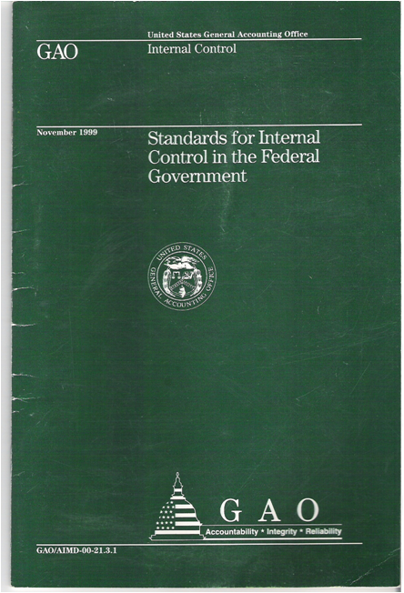
Standards for Internal Control in the Government
Going Green
44

Slide 45
Reasons for Green Book Revision
  Last issued in November 1999
  Adapt to a more global, complex, and technological landscape
  Maintain relevancy to changing standards
  Harmonize federal standards with the updated Committee of Sponsoring Organizations of the Treadway Commission (COSO) Framework

Slide 46
What’s in Green Book for the Federal Government?
Reflects federal internal control standards required per Federal Managers’ Financial Integrity Act (FMFIA)
Serves as a base for OMB Circular A-123
Written for government
  Leverages the COSO Framework
  Uses government terms

Slide 47
What’s in Green Book for
State and Local Governments?
May be an acceptable framework for internal control on the state and local government level under proposed OMB Uniform Guidance for Federal Awards
Written for government
  Leverages the COSO Framework
  Uses government terms

Slide 48
What’s in Green Book for Management and Auditors?
Provides a framework for management
Provides criteria for auditors
Can be used in conjunction with other standards, e.g. Yellow Book

Slide 49
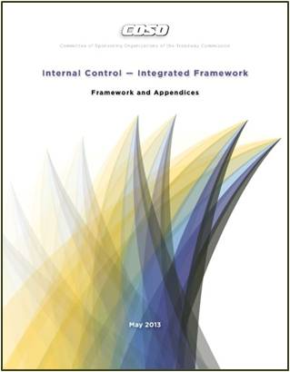
Updated COSO Framework
Released
May 14, 2013

Slide 50
Internal Control: COSO Framework
Published by COSO
  COSO is sponsored by
    American Accounting Association (AAA)
    American Institute of Certified Public Accountants (AICPA)
    Financial Executives International (FEI)
    Institute of Management Accountants (IMA)
    Institute of Internal Auditors (IIA)
Established:
  Common internal control definitions
  Internal control components
Notes:
Green Book definitions and elements are from COSO.
GAO did not “invent this” but makes this framework applicable to federal agencies in the U.S.
COSO is an internationally used, widely accepted framework.

Slide 51
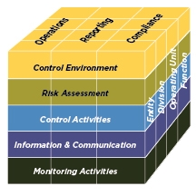
The COSO Framework
Relationship of Objectives and Components
      Direct relationship between objectives (which are what an entity strives to achieve) and the components (which represent what is needed to achieve the objectives)
COSO depicts the relationship
in the form of a cube:
  The three objectives are represented
by the columns
  The five components are represented
by the rows
  The entity’s organization structure is
represented by the third dimension
Source: COSO

Slide 52
Updated COSO Framework
Retains the five components and adds principles and points of focus
Sets out 17 principles
  Fundamental concepts associated with the components
Each principle is supported by related points of focus
  Represent characteristics associated with the principles

Slide 53
Updated COSO Framework:
Components of Internal Control
Control Environment
Demonstrates commitment to integrity and ethical values
Exercises oversight responsibility
Establishes structure, authority and responsibility
Demonstrates commitment to competence
Enforces accountability
Risk Assessment
Specifies suitable objectives
Identifies and analyzes risk
Assesses fraud risk
Identifies and analyzes significant change
Control Activities
Selects and develops control activities
11. Selects and develops general controls over technology
Deploys through policies and procedures
Information & Communication
Uses relevant information
Communicates internally
Communicates externally
Monitoring Activities
Conducts ongoing and/or separate evaluations
Evaluates and communicates deficiencies

Slide 54
From COSO to Green Book: Harmonization
COSO
Green Book

Slide 55
Green Book Revision Process
Retained five original COSO components
Adapted COSO Framework’s language
to make it appropriate for a federal
government standard
Adapted the concepts for a government environment where appropriate
Considered clarity drafting conventions
Considered INTOSAI internal control guidance

Slide 56
Revised Green Book:
Standards for Internal Control in the Federal Government
Overview
Standards

Slide 57
Revised Green Book: Overview
Overview
Standards
Explains fundamental concepts of internal control
Addresses how components, principles, and attributes relate to an entity’s objectives
Discusses management evaluation of internal control
Notes:
Definition of Internal Control
Internal control is an integral component of an entity’s management that provides reasonable assurance that the objectives of an entity are being achieved.
An Internal Control System
An internal control system is a continuous built-in component of operations, effected by people, that provides reasonable assurance, not absolute assurance, that an organization’s objectives will be met.
Evaluation of an Internal Control System
Management evaluates the effectiveness of the design, implementation, and operation of the entity’s internal control system.

Slide 58
Overview: Components, Principles, and Attributes
Overview
Achieve Objectives
Principles
Attributes
Components
Standards
Notes:
Need to add a definition next to “Principles” and “Attributes”

Slide 59
Overview: Principles and Attributes
In general, all components, principles,
and attributes are required for an
effective internal control system
Principles and Attributes
  Entity should implement relevant principles and attributes
  If a principle or attribute is not relevant, document the rationale of how, in the absence of that principle or attribute, the associated component could be designed, implemented, and operated effectively
Overview
Standards
Notes:
Need to revise to tell story of how the principles and attributes work for effective IC. Also need additional slide to explain principles, attributes how handled approached in GB
Management must comply with an unconditional requirement.
Management must comply with a presumptively mandatory requirement where such a requirement is relevant.
Application Material – Additional Information
Application material provides further explanation of the requirements using the words may, might, and could.

Slide 60
Overview: Management Evaluation
An effective internal control system requires
that each of the five components are:
Effectively designed, implemented, and operating
Operating together in an integrated manner
Management evaluates the effect of deficiencies on the internal control system
A component is not likely to be effective if related principles and attributes are not effective
Overview
Overview
Standards
Standards

Slide 61
Revised Green Book: Standards
Control Environment
Risk Assessment
Control Activities
Information and Communication
Monitoring
Overview
Standards

Slide 62
Revised Green Book: Standards
(Continued)
Overview
Standards
Discusses requirements of each component
Explains principles and attributes for each component
Includes application material for each attribute
Notes:
Definition of Internal Control
Internal control is an integral component of an entity’s management that provides reasonable assurance that the objectives of an entity are being achieved.
An Internal Control System
An internal control system is a continuous built-in component of operations, effected by people, that provides reasonable assurance, not absolute assurance, that an organization’s objectives will be met.
Evaluation of an Internal Control System
Management evaluates the effectiveness of the design, implementation, and operation of the entity’s internal control system.

Slide 63
Standards: COSO vs. Green Book
Component | COSO | Green Book
Control Environment | 5 Principles 20 Points of Focus | 5 Principles 13 Attributes
Risk Assessment | 4 Principles 27 Points of Focus | 4 Principles 10 Attributes
Control Activities | 3 Principles 16 Points of Focus | 3 Principles 11 Attributes
Information & Communication | 3 Principles 14 Points of Focus | 3 Principles 7 Attributes
Monitoring | 2 Principles 10 Points of Focus | 2 Principles 6 Attributes
Overview
Standards
Note: GAO combined COSO’s points of focus into attributes

Slide 64
Standards: Harmonization from COSO to Green Book
Overview
Commercial Concepts
Government Concepts
Standards
Board of Directors
Investors
Oversight Body
Stakeholders
Notes:
Need to add terms

Slide 65
Standards: Harmonization Example
Overview
  COSO (Principle 2)
  The board of directors demonstrates independence from management and exercises oversight of the development and performance of internal control.
  Green Book (Principle 2)
The oversight body should oversee the entity’s internal control system.
Standards

Slide 66
Green Book Revision
Proposed Timeline
Outreach to User Community
Green Book Advisory Council
Public Exposure (90 day comment period)
Finalize
Ongoing
May 20, 2013
Summer 2013
2014

Slide 67
Green Book Advisory Council
Representation from:
  Federal agency management (nominated by OMB)
  Inspector General
  State and local government
  Academia
  COSO
  Independent public accounting firms
  At large

Slide 68
Definition of Internal Controls
Internal control is an integral part of an organization’s management that provides reasonable assurance that the agency’s objectives are being met in the following categories:
  Effectiveness and efficiency
  Reliability of financial reporting
  Compliance with laws and regulations
  Safeguarding of assets
Internal control serves as the first line of defense in safeguarding assets (including public funds) and preventing and detecting errors and fraud.
Internal control helps managers achieve program results through effective stewardship of public resources.
Notes:
Green Book definitions and elements are from COSO.
GAO did not “invent this” but makes this framework applicable to federal agencies in the U.S.
COSO is an internationally used, widely accepted framework.

Slide 69
Responsibility for Internal Control
Who is responsible for internal control?
  Management is responsible for the following, with regard to internal controls
      designing,
      implementing,
      reviewing, and
      improving.

Slide 70
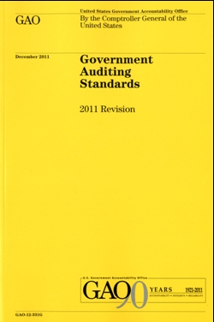
The Yellow Book: Framework for Audits
Findings are composed of
  Condition (What is)
  Criteria (What should be)
  Cause
  Effect (Result)
  Recommendation (as applicable)

Slide 71
Linkage Between Criteria (Yellow Book) and Internal Control (Green Book)
Green Book provides criteria for the design, implementation, and operating effectiveness of an effective internal control system

Slide 72
The Yellow Book: Framework for Audits
Findings are composed of
  Condition (What is)
  Criteria (What should be)
  Cause
  Effect (Result)
  Recommendation (as applicable)

Slide 73
Linkage Between Findings (Yellow Book) and Internal Control (Green Book)
Findings may have causes that relate to internal control deficiencies

Slide 74
Green Book and Yellow Book
Can be used by management to understand requirements
Can be used by auditors to understand criteria
Notes:
Management: Requirements of internal control compliance and the standards to which they are being held when being audited.
Auditors: What to use to evaluate management and how to evaluate management.

Slide 75
What are the five standards for internal control?
The five standards for internal control are
  Control Environment
  Risk Assessment
  Control Activities
  Information and Communications
  Monitoring
Notes:
The five standards of internal control are described in Standards for Internal Control for the Federal Government, GAO/AIMD-00-21.3.1, Nov. 1999.
These are based on COSO.
OMB A-123 now uses these elements.
INTOSAI uses these elements.
Corporations and governments around the world refer to these components.

Slide 76
Control Environment
Control Environment sets the tone of an organization, influencing staff
awareness of good controls, procedures, accountability, and program
management. It is the foundation for all other components of internal control,
providing discipline and structure.
Red Flags
  The agency or program has recently undergone major change– e.g. new responsibilities, reorganization, cuts in funding, expansion of programs, changes in management.
  Employees are generally disgruntled.
  Top management is unaware of actions taken at the lower level of the organization.
  The organizational structure is inefficient or dysfunctional.
Notes:
Elements of the Control environment are:
Personal and professional integrity and ethical values of management and staff, including a supportive attitude toward doing things right
Commitment to competence
Tone at the top
Organizational structure
Human resources policies and practices

Slide 77
Risk Assessment
Risk Assessment is the identification and analysis of relevant risks
associated with achieving program or agency objectives, such as those
defined in strategic and annual performance plans, and forming a basis for
determining how risks should be managed.
Red Flags
  The agency or program does not have well-defined objectives.
  (If the agency does not know what it is trying to accomplish, it will not be able to adequately assess risks).
  The agency or program does not have adequate performance measures.
  (If you don’t know how to measure success or whether the program is successful, you will not be able to adequately assess risks).
  The agency or program does not have an adequate strategic plan.
Notes:
Generally, risk identification and assessment is an ongoing, iterative management process related to strategic planning and defining of program objectives. Management uses the results of risk assessment in deciding how to allocate resources and mitigate risks, and what types of control activities and management involvement are needed.

Slide 78
Control Activities
Control Activities are the policies and procedures established to achieve
the entity’s objectives. They help ensure that management’s directives are
carried out in daily program operations.
Red Flags
  Agency or program is understaffed and/or workload has drastically increased, and staff are having difficulties handling operational workload.
  There have been previous issues with fraud, waste, or abuse.
  Employees are unaware of policies and procedures, but do things the way “they have always been done.”
  Key documentation is often lacking or does not exist.
Notes:
This is basic, nuts and bolts stuff, and probably the easiest part of the control framework to understand.
Examples of control activities include
Authorization and approvals for transactions and other events.
Verifications and reconciliations.
Controls over access to assess, resources, and records.
Management-level reviews of program performance and other activities.
Documentation of transactions, approvals, and other significant management involvement in program activities.
Supervision, including assigning, reviewing work, training.
Development of formal policies and procedures to govern the above.

Slide 79
Information and Communication
Information and Communication is needed by management and employees
to monitor progress in meeting the organization’s mission and objectives while
maintaining proper accountability and internal control.
Red Flags
  When top management needs information, there is a mad scramble to assemble the information, or the process is handled through ad hoc mechanisms. (e.g. the information was not readily available).
  Staff are frustrated by requests for information because it is time-consuming and difficult to provide the information.
  Management does not have reasonable assurance that the information it is using is accurate.
Notes:
Management and staff need information that is
Appropriate (is the needed information there?)
Timely (is the information available when it is needed?)
Current (Is the latest information available?)
Accurate (Is the information reliable?)
Accessible (can the information be obtained easily by the relevant parties?)

Slide 80
Monitoring
Monitoring is accomplished through routine, ongoing activities, separate
evaluations, or both. Internal control systems should be monitored to assess
their effectiveness and to modify procedures as appropriate based on results
of the monitoring activities (feedback).
Red Flags
  Previous audit findings are not being resolved adequately or timely.
  Significant problems exist in controls and management was not aware of those problems until a big problem occurred; or until another outside party brought it to their attention (e.g. a recipient of funding, or an external audit).
Notes:
Ongoing monitoring is built into the normal, recurring operating activities of an entity. It includes regular supervisory activities, reviews, and quality control procedures.
Separate evaluations performed by management may also be appropriate based on risk and the effectiveness of ongoing monitoring procedures.
The monitoring process should also be used to ensure that audit findings and recommendations are adequately and promptly resolved.

Slide 81
Where to Find the Green Book
Once exposed, the Green Book will be on GAO’s website at: www.gao.gov
For technical assistance, contact GOA at: greenbook@gao.gov
Notes:
81

Slide 82
Municipal Securities Issues
Notes:
Let’s set the stage. Why do we need to be talking about this topic, and why is it timely to talk about it now?
The rules around auditor association with SEC-registered offerings are well understood.
Because of liab the auditor assumes in connection with a ‘33 Act, auditor must give consent to use of opinion and as a result must perform certain procedures prescribed by the SEC.
Investing public is aware of that and has come to depend on it.
But of course, once you move outside the registered offering arena, the offering is no longer subject to those specific SEC requirements.
However, often an “expectation gap” involving the investing public,
They tend to carry their knowledge and beliefs related to registered offerings over to muni offerings
Therefore, if they see auditor’s report in OS, may automatically assume that auditor has consented to inclusion and has done certain procedures. Perhaps they derive some false comfort from that. The SEC has been very focused on this.
So how does that affect what we’re going to talk about today?
Well, even though we don’t have SEC rules, we do have AICPA rules that govern us in this area.
The goal today is to boost your familiarity with what those rules are and the reasons behind them…..
….in particular the rules on what circumstances causes you to have to perform procedures around a client’s bond offering document
We’re going to talk about some ways to help ensure that if your firm’s name is used in the offering but you are NOT associated, that the investing public has some clear messaging around the fact that you were not involved, so they don’t derive comfort that doesn’t exist
So that’s our general objective. How are we going to cover the info?

Slide 83
Topics to be Covered
Sources of AICPA guidance
Association with official statements
  Mandatory association
  Voluntary association
  Non-association
Association with continuing disclosure documents
Update on recent SEC developments
  Reports to Congress on muni market regulation
  EMMA overview
  Increased scrutiny of underwriter due diligence
83
Notes:
As you can see from agenda, first, we’ll review the SOURCES of guidance on auditor association.
Then, we’ll look at auditor association considerations in connection with what’s called primary market disclosure (which is the official statement issued in connection with issuance of new bonds)….
…. and in connection with secondary market disclosure (which would be in connection with information reported to bondholders and the market subsequent to issuance of the bonds). These are also known as “continuing disclosure documents.”
Finally, we’ll take a look at some recent developments involving potential regulation of the muni market and how things might be changing.
Acknowledge Jeff and Mary.

Slide 84
Glossary
OS | Official Statement – disclosure document prepared in connection with initial sale of new securities. Also referred to as “primary market disclosure.”
Continuing Disclosure | Disclosure documents issues subsequent to initial sale of securities (throughout the life of the bond issue). Also referred to as “secondary market disclosure.”
EMMA | MSRB’s Electronic Municipal Market Access system
EDGAR | SEC’s Electronic Data Gathering and Reporting system
MSRB | Municipal Securities Rulemaking Board
AAG-SLV | AICPA audit and accounting guide “State and Local Governments”
GAAS | Generally-accepted auditing standards
Rule 15c2-12 | SEC rule, “Municipal Securities Disclosure”
SAS 76 letter | Special form of comfort letter utilized in non-registered offerings
84
Notes:
Add “Registered offering” or “33 Act Offering”

Slide 85
Sources of AICPA guidance
AICPA audit & accounting guides
  State and Local Government (AAG-SLV): Chapter 16, “Auditor Association with Municipal Securities Filings”
  Health Care Entities (AAG-HCO): Chapter 7, “Municipal Bond Financing”
  Not-for-Profit Entities (draft new AAG-NPO exposed for comment 8/15/2012): Chapter 10, “Debt & Other Liabilities”
AU 9711 -- Interpretations of AU 711, Filings Under Federal Securities Statutes
  Interpretation No. 2, “Consenting to Be Named as an Expert in an Offering Document in Connection With Securities Offerings Other Than Those Registered Under the Securities Act of 1933”
  Interpretation No. 3, "Consenting to the Use of an Audit Report in an Offering Document Other Than One Registered Under the Securities Act of 1933”
85
Notes:
What are the AICPA rules that apply to us in this area?
Bear in mind as we’re going thru this that we are not focusing on the financial statements that have been audited – those belong to management. We’re focusing on the auditor’s report on a set of financial statements, and the professional responsibilities you have under the AICPA standards after it is signed
1. Guides…. Much of guidance promulgated by ASB/AITF for muni offerings is based on AU711
2. AU711 The AICPA rules established by the guides are based on the guidance in AU 711
In addition, interp of 711 contains some guidance specifically for non-registered offerings.
3. A third one I left off is AU634, comfort letters. We’ll also be talking about it.

Slide 86
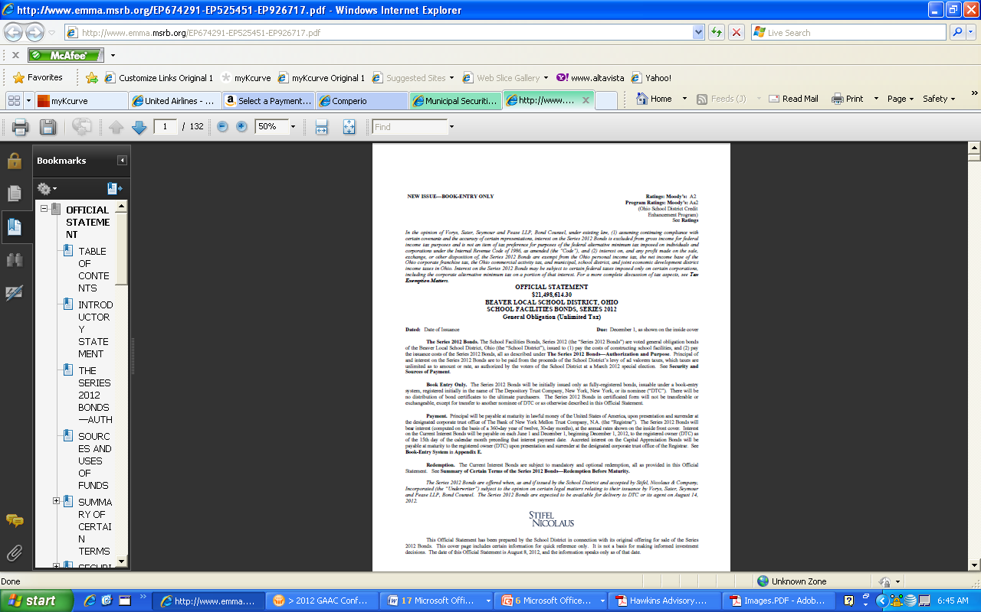
Auditor association -- official statements
Key principle: Association can be mandatory or voluntary
86
Notes:
As we already talked about –
In SEC registered filings, an auditor MUST consent to the use of his/her opinion in the registration statement. When he does, he is associated with the document and must, under professional standards, perform certain procedures (see discussion later).
In the muni world, that’s not the case. In the muni world, there are 3 possibilities
The auditor is associated because certain events have occurred. This is “mandatory” association.
The auditor is associated based on the firm’s own risk management policies. This is “voluntary” association.
The auditor is NOT associated and has not done any procedures.

Slide 87
Auditor association -- Official Statements (OS)
Actions that trigger mandatory association
  Consenting” to use of report in OS (i.e., providing inclusion letter)
  Issuing comfort letter, SAS 76 letter, or agreed-upon procedures (AUP) report related to OS
  Reviewing draft of OS at client's request
  Assisting in preparing financial information included in OS
  Signing (either manually or electronically) an auditor’s report for inclusion in a specific OS
  Providing a “customized” auditor's report for inclusion in an OS
  Performing attestation engagement relating to the debt offering
(AAG-SLV 16.07)
Relatively straightforward
A little trickier! See following slides
87
Notes:
Let’s first talk about “mandatory association.” The audit guides specify seven “triggering events”.
We’re going to walk thru them, but before we do I’d like to tee up the general principle that underlies them.
That principle is, if something occurs that puts you "on notice" that your audit report is going to be used in connection with a sale of securities, you have an obligation under the professional standards to ensure that your report has not been called into question and is being appropriately used.
Some read pretty straightforward, others can be a little confusing, so we’ll talk about each one individually.
The first three are self-explanatory. The next four have proven to be a little more confusing.
1. The first one is the obvious one. The client calls you up and says, we’re going out for bonds, do I have your permission to include your opinion in the offering document.
In this case, you have “consented” in writing to allowing your report to be used. We’ll talk a little later about what that means and what the professional rules are around consenting in a muni offering.
If you know that, then you have a professional responsibility to ensure that nothing has happened between the date you issued your report and the date of the offering that would cause you to render a different opinion – in other words, that the opinion you have has not been called into question – and also that no information is presented in that offering document which might call your opinion into question. We’ll talk about that more later, when we talk about what your responsibilities are.
2. client calls you and says, “We’re going to go out for bonds, the underwriter wants you like for you to do some comfort letter type procedures.
In other words, underwriter wants you, the auditor, to provide him or her with a comfort letter or agreed-upon procedures to assist them with their due diligence in connection with the offering(explain). In that case, you know that an offering is underway.
In a muni offering, we can’t just do a comfort letter like we would in a 33 act offering. Typically, we do agreed upon procedures.
3. The third one of these is that the client calls you and says, “we’re going out for bonds, I’m sending over a draft and would like for you to take a look through it to see if anything jumps out at you.”
If a comfort letter is requested by a party other than the underwriter, broker-dealer, or other financial intermediary, the accountant is not permitted to provide that party with a SAS 72 comfort letter or a SAS 76 letter. Instead, the auditor may provide the party with a report on agreed-upon procedures. In an AUP report, no assurance is given; the auditor merely reports findings (e.g., agreed the total of the consolidating schedule to the audited consolidated balance sheet).

Slide 88
Actions that trigger mandatory association
Assisting in preparing financial information included in Official Statement
  In this situation, financial information does not refer to financial statements covered by the auditor's opinion or the required supplementary information (RSI) or supplementary information other than RSI accompanying those financial statements that the auditor already considered during his or her audit of the financial statements.
88
Notes:
The 4th is “assisting in preparing financial information included in the OS.”
This is, of course, NOT referring to the financial statements that you audited or the RSI accompanying those statements, as you must be independent with respect to that information. This might be if, for example, you assisted the client with pulling together information on five years of historical data. If the client says, Hey can you help me pull together these schedules for my bond offering document, then you are on notice that your report could be being used.
.

Slide 89
Actions that trigger mandatory association (continued)
Signing (either manually or electronically) an auditor’s report for inclusion in a specific OS
  This refers to the auditor providing an auditor’s report with an original manual or electronic signature. It is not referring to a reproduction of an auditor's report that was manually or electronically signed.
  For example, the underwriter or bond counsel may require a copy of the auditor's report with an original manual or electronic signature to file with the official closing documents for the offering.
89
Notes:
The fifth is manually signing (or electronically signing) a report for inclusion in an OS. This isn’t talking about the opinions that you manually signed when you delivered 50 copies of the financial statements to the client, that might end up being reproduced in a bond offering document. This is talking about a situation where the underwriter or bond counsel specifically asks for an original report with a manual signature (or the electronic equivalent) to put with the closing documents. You know that an offering is in process.

Slide 90
Actions that trigger mandatory association (continued)
Providing a “customized” auditor’s report for inclusion in a specific official statement
  The reports required by Government Auditing Standards (Yellow Book) are restricted-use under AU 532; thus, they should not be included in an OS (a widely-distributed document)
  AAG-SLV 16.13: “It generally is advisable for an official statement to use an auditor's report on the financial statements that does not refer to the Government Auditing Standards audit or to the reports required thereunder, because those references could confuse the users of the official statement.”
    Thus, the auditor might provide a “plain-vanilla” GAAS audit report specifically for inclusion in the bond offering document.
90
Notes:
#6 is “you provide a “custom” version of the auditor’s report for inclusion in an official statement. This refers to some guidance in another section of Chapter 16 that discusses the appropriateness of including yellow book reports in an offering document.
If you’re doing a yellow book or A-133 audit, you have your GAAS report on the financial statements and then you have reports required under Gov Audt Standards – internal control over financial reporting compliance with laws regulations and contracts also certain fraud and abuse.
Now, both the “yellow book” audit guide and the SLG guide state that those yellow book reports of those reports are “limited distribution” reports. So you have this plain vanilla GAAS report on the financial statements coupled with limited use reports.
If you have that situation, the preferable thing to do so that you don’t run the risk of confusing the
Just issue a plain-vanilla GAAS audit opinion that just talks about the …..
It was brought up back when we did this in august that the clarified standards may be relaxing the restrictions on whether yellow book reports are considered limited use.
I think the key point is, there’s no obligation to put the yellow book reports in an offering document. If all that’s in there are the financial statements, the plain vanilla GAAS report may be preferable.
What if at the time you gave your 50 signed copies of the yellow book report you also gave 50 ocpies of the plain vanilla report. Does this trigger association? No, we’re talking about situations where you are specifically asked for an opinion in connection with a particular offering.

Slide 91
Actions that trigger mandatory association (Continued)
Performing an attestation engagement related to the debt offering
  In connection with issuing bonds, the auditor may be engaged to attest to certain information specifically associated with the offering (see AAG-SLV 16.23)
VERIFICATION OF MATHEMATICAL ACCURACY
The accuracy of (i) the arithmetic computations supporting the conclusion that the principal amounts of, and interest earned on, the government obligations to be acquired with a portion of the proceeds of the Series 2012 Bonds, together with other monies, if any, are sufficient to pay the Redemption Price of and interest on the Refunded Bonds due through and including the Redemption Date and (ii) the mathematical computations supporting the conclusion that the Series 2012 Bonds will not be "arbitrage bonds" under the code, will be independently verified by ABC CPAs.
91
Notes:
Here, we’re not talking about comfort-letter type AUP.
We’re talking about where auditor is engaged to attest to certain financial information associated with the lffering.
Example here, I went into EMMA. They give you an option, pull up recent offering documents.
Indicates that auditors were also asked to verify the math on the escrow calculations in a refunding and also that the bonds will not be arbitrage bonds.
Sometimes the question comes up, what if I’m engaged to do that type of engagement but I’m not the financial statement auditor? Does that sweep me in?
Remember that association is focused on the use of the financial statement auditor’s report.
This is only talking about situations where the CPA firm has also rendered a report on the financial statements that is included in the offering document. In the other case, there is no audit report to perform procedures on!
***
So those are the seven triggers. Earlier I indicated that there’s an underlying principle that links them all together. that if you are aware that your report is going to be used in connection with a sale of securities, then you have an obligation.
Focus on the spirit of the guidance and not on a literal application. These were written a long time ago, and don’t cover situations where an email went astray. A colleage with another firm and I gave a talk to a group of bond lawyers. He described a story where a client copied him by accident on an email talking about the upcoming bond offering which he didn’t otherwise know about. The client sent him an “oops,” sorry, please disregard, but he said “look, I can’t. Now that I know about it, I have a professional obligation to ensure that my report is still appropriate.”

Slide 92
Requirements when auditor is associated
“Keeping current” procedures related to auditor’s report (AU 560.12) [SUBSEQUENT EVENTS]
  Read all available information relating to the entity's financial and accounting matters
  Make inquiries
  Inquire of legal counsel
  Obtain a management representation letter related to subsequent events period
Reading the O/S (AU 550) [NOW AU-720], “OTHER INFO IN DOCS CONTAINING AFS”
  Be alert for information that is materially inconsistent with what’s in the financial statements covered by the auditor’s report
92
Notes:
So if you are associated, what are you required to do?
NOTE: FROM THE RECENT DISCUSSIONS THAT HAVE TAKEN PLACE, I WENT TOO FAR IN THE FOLLOWING PARAGRAPH, SO THIS NEEDS TO BE MODIFIED.
*********
The SLG guide (and now the healthcare guide and soon the NFP guide) requires you to do two things. The first is, do keeping current procedures. This is just referencing the general rule related to what you must do if asked to reissue your report. The first set of procedures is aimed at, has anything happened since I issued my opinion that might call it into question. This is really just an extension of your subsequent events review. Not really any substantive auditing procedures, ……
*********
The second part have to do is read the official statement and consider whether what’s in the rest of it (or the manner of its presentation) is materially inconsistent with information appearing in the AFS.
Give the war story
Point:
Something is wrong. Either the AFS that we issued an opinion on are wrong, or something
But the point of that is, the muni offerings, just like the registered offerings, material misstatement of fact in an official statement
If you have an offering document that has a big inconsistency…….you’ve got a misstatement of fact. In that case, having the opportunity to do that gave the issuer the opportunity to avoid putting a document out on the market that contained a misstatement of fact.

Slide 93
Describing the auditor’s role
If auditor’s role is described in the OS, use the following language:
  INDEPENDENT AUDITORS
  The financial statements as of December 31, 19XX and for the year then ended, included in this offering circular, have been audited by ABC, independent auditors, as stated in their report(s) appearing herein.
    References:
    AAG-SLV par.16.20
    AU Section 9711, Auditing Interpretations of Section 711, “Filings Under Federal Securities Statutes,” Interpretation No. 2
93
Notes:
Let’s assume that you are associated. We also have guidance from the ACPA standards also describe how your role should be described in an offering that is not registered (if there’s a desire to describe the role)
Gives you a simple statement of fact.
The reason becomes more apparent if we look at the next slide.
AICPA professional standards state that when the issuer wishes to make reference in the OS to the auditor's role, the caption "Experts" should not be used, and the auditor may not be referred to anywhere in the document as an "expert." This is because the terms "expert" and "expertization" are associated with '33 Act filings, where the terms are used with a specific meaning. Outside of that arena, the terms are typically undefined, and the auditor's responsibility therefore also is undefined.
In a '33 Act filing, "expertization" typically is associated with an underwriter's due diligence. Financial and accounting data that is "expertized" is covered by the auditor's report.
Professional standards require that if the client refuses to delete from the offering document the reference to the auditor as an "expert," the auditor should not permit inclusion of the auditor's report in the offering document.

Slide 94
Describing the auditor’s role (Continued)
Inappropriate references – “expertization”
    The financial statements as of December 31, 19XX and for the year then ended, included in Appendix A of this offering circular, have been audited by ABC CPAs, independent auditors, as stated in their report appearing herein.
EXPERTS
    INDEPENDENT ACCOUNTANTS
    Set forth in Appendix A are the consolidated financial statements of the District for the fiscal year ending June 30, 2011 as audited by ABC CPAs. These audited financial statements have been included in reliance upon the reports of such firm
given their expertise
in accounting and auditing.
94
Notes:
Both of these examples could be problematic….may appear you are willing to assume 33 act liability for your opinion in the same way you would if it were a registered offering.
In the first one, they used the correct language but put it under an inappropriate heading.
In the second one, they used the plain vanilla heading, but they used the 33 act language for describing the role

Slide 95
Consents (inclusion letters)
In muni offerings, a “consent” is called an “inclusion letter”
Issuance of an inclusion letter is not required by professional standards
If inclusion letter is requested, use language such as:
    We agree to the inclusion in [identify the document] of our report, dated February 5, 20XX, on our audit of the financial statements of [name of entity].
    References:
    AAG-SLV par.16.21-.22
    AU Section 9711, Auditing Interpretations of Section 711, “Filings Under Federal Securities Statutes,” Interpretation No. 3
95
Notes:
Often they will ask for something in writing from you. So while it’s not required, you can give it.
Again, “consent” drives that notion that you are cocnseting to liability like what you would have under a 33 Act offering.
The term “consent” also tied to the explicit acceptance of liability in connection with a registered offering so again, we are cautioned to stay away from it.
Certain protocols which must be followed with respect to the form, content, and address of an inclusion letter.
The deliverable should be in the form of a separate letter issued to the client (not the board of directors, as is done in addressing an audit report).
The deliverable should be worded pursuant to the requirements of AICPA professional standards as follows:
We agree to the inclusion in this [name of document] of our report, dated February 5, 20XX, on our audit of the financial statements of [name of entity].
The effective date of the letter can be the preliminary official statement date or the official statement date.
Interpretation No. 3 of SAS No. 37, “Consenting to the Use of an Audit Report in an Offering Document Other Than One Registered Under the Securities Act of 1933”(AU sec. 9711.16–.17).

Slide 96
Voluntary association SKIP OVER AND COME BACK TO AFTER NONASSOCIATION
Occurs when engagement letter requires client to request auditor’s permission to use auditor’s report in connection with a sale of securities
  In such cases, auditor is associated even if no “mandatory” triggers have occurred
“The Company may wish to include our report on these financial statements in a registration statement proposed to be filed under the Securities Act of 1933 or in some other securities offering. You agree that the aforementioned audit report, or reference to our Firm, will not be included in any such offering without our prior permission or consent. Any agreement to perform work in connection with an offering, including an agreement to provide permission or consent, will be a separate engagement.”
  Important: Both parties should understand what constitutes “use of the report”
96
Notes:
So none of the
Ceertain firms, as a risk management…..you must notify us and give us the opportunity to perform procedures to ensure that our report is still valid, and that there’s nothing in the audit document that would call the opinion we rendered into question.
We want the opportunity to have been able to look at things thoroughly….taking it on the offensive It’s part of the engagmeent letter.
Have an equally valid approach to risk management, do not have this provision in the engagement letter. ….the larger the firm you’re associated with, the deeper the pockets you are perceived to have, the more important that discussion becomes.
“non-association”
Views on what constitutes "using the report" can differ from firm to firm, so it is important for the client and auditor to understand the terms of use. In some firms, it may simply refer to reproducing the auditor's report in the OS; in others, it may also include situations where the auditor's report is not included in the OS; for example, that audited financial statements including the auditor's report are available upon request, or where the audit firm is named in the OS as the independent auditors.
***
Additionally, association is triggered if an auditor includes a provision in the engagement letter requiring the client to request permission from the auditor before using the report in an OS (in other words, to require that they become associated with a government's official statements even if the above events have not occurred). Views on what constitutes "using the report" can differ from firm to firm, so it is important for the client and auditor to understand the terms of use. In some firms, it may simply refer to reproducing the auditor's report in the OS; in others, it may also include situations where the auditor's report is not included in the OS; for example, that audited financial statements including the auditor's report are available upon request, or where the audit firm is named in the OS as the independent auditors.
Some CPA firms internal policies related to risk management require that such a provision be include in the engagement letter. Because the auditor's legal liability increases when its opinion is included in an OS, firms with such risk management policies are required to (a) determine that its audit report as originally issued is still appropriate (e.g., that no subsequent events have occurred which would call that opinion into question), and (b) that none of the other information contained in the OS calls into question or contradicts what's in the audited financial statements covered by the auditor's report. If such information is noted during the auditor's reading of the OS and it is determined that the information is not in error, it potentially could require the client to restate and reissue its financial statements, and for the auditor to reissue and modify its opinion. Alternatively, if the other information is determined to be incorrect, the auditor will insist that it be corrected to avoid a potential misstatement of fact. (For example, the description of the legal organization included in the OS might refer to a legal entity that, if known to the auditor, might have required inclusion in the financial statements in order for the display of the reporting entity to comply with GAAP. )

Slide 97
Non-association – MOVE THIS AHEAD
Best practice
  Consider including a requirement in the engagement letter that any OS issued by the client with which the auditor is not associated will contain language clearly indicating that the auditor is not associated (AAG-SLV 16.12)
  ABC CPAs, the independent auditor for the Town, has not been engaged to perform and has not performed, since the date of their report included herein, any procedures on the financial statements addressed in their report included in this Official Statement. ABC CPAs also has not performed any procedures relating to this Official Statement.
97
Notes:
So what if nothing has occurred that has put you on notice that your audit report is going to be used in an offering? You haven’t been asked for an inclusiion letter, you haven’t been asked to do AUP, you haven’t been asked for a manually-signed opinion.
Remember the expectation gap we talked about earlier, where investors tend to carry over their knowledge and beliefs about registered offerings to muni offerings?
the EP identified as a best practice that unless your firm policy is voluntary association – which we’ll talk about in a minute -- put some sort of provision in your engagement letter requiring the client to put a statement like this in the ofering document.
there that syas, if you use our opinion and we’re not aware of it, then you agree to put a statement in your official statement…..auditors have not been engaged and in fact, have not done any procedures in that.
While this is identiifed as a best practice, its an important thing to put in to address that “expectation gap”

Slide 98
Auditor association with official statements
Can you spot the inconsistency?
    GENERAL CONSIDERATIONS
  The District's financial statements for the year ended June 30, 2011, were audited by ABC CPAs, and have been included herein as Appendix A. ABC CPAs has agreed to the publication of its audit opinion on such financial statements in this OS. ABC CPAs has not been engaged to perform any updating procedures subsequent to the date of its audit report on the June 30, 2011 financial statements.
98
Notes:
If ABC CPAs has given their consent, then under professional standards they MUST perform procedures.
Hopefully, the more we talk about these requirements, the more consistent the messages will become.

Slide 99
Auditor association with continuing disclosure documents
“Continuing disclosures” = disclosure documents disseminated subsequent to initial issuance of the bonds
Also referred to as “secondary market disclosure”
99
Notes:
Is the auditor associated with that? The audit guide says “no.”

Slide 100
Continuing disclosure requirements
SEC Rule 15c2-12
  Issuer/obligor must agree to implement a system of continuing disclosure that remains in effect as long as the bonds are outstanding.
  The core of this system is the continuing disclosure agreement
Continuing disclosure agreement
  Issuer/obligor covenants to provide certain specified information to bondholders throughout life of bond issue
  Required elements
    Annual reporting of financial and operating information
    Reporting of significant events
  Quarterly reporting requirement may also be established as part of the covenant (but is not mandatory under Rule 15c2-12)
100

Slide 101
Comparison:
’34 Act requirements vs. muni requirements
Disclosure filings required subsequent to initial issuance of securities
 | Registrants | Muni issuer/obligors
Periodic filings | 10-K | Annual financial/operating info
 | 10-Q | Quarterly filings (if required by covenant)
 | 8-K | Event notices
Filing site | EDGAR | EMMA
101
Notes:
The muni system is much less prescriptive than the system of periodic reporting required of publicly-traded companies.

Slide 102
Auditor association – continuing disclosure filings (AAG-SLV 16.10)
AU 550 does not apply to continuing disclosure documents that contain audited financial statements (e.g., combined filing that includes both annual operating information and audited financial statements)
Auditor is not required to undertake any procedures with respect to a client's continuing disclosure documents, even if those documents include audited financial statements
102

Slide 103
Overview of municipal securities regulatory framework today
Existing exemptions
  Muni securities generally exempt from Securities Act of 1933 registration requirements
  State and local governments generally exempted from Securities Exchange Act of 1934 reporting requirements
  However, no exemptions provided from the anti-fraud provisions of either the ’33 or ‘34 Acts
SEC’s limited authority over municipal market is derived from
  Ability to prohibit underwriters from purchasing muni bonds unless issuer covenants to provide certain information to investors at initial issuance and throughout life of the bonds (SEC Rule 15c2-12)
  Enforcement authority over anti-fraud provisions
Notes:
It’s a covenant between the underwriter and the party issuing the bonds. Back-door regulatory framework.
Should the SEC be given
Congress said, look at the quality of the disclosure compared to the quality of discllsoures made in 33 act offerings. See if investors in muni offerings are being shortchanged.
Currently, the SEC’s enforcement authority against
municipal issuers is limited to violations of the general antifraud
provisions of the federal securities laws.3
While the SEC does not regulate muni issuers, it has tried to indirectly impose disclosure requirements on issuers through broker-dealers. The SEC’s Rule 15c2-12 on muni disclosure, for example, prohibits dealers from underwriting most municipal securities unless issuers have entered into written agreements to disclose annual financial and operating information, as well as notices of events such as principal and interest payment delinquencies or bankruptcy filings, when they occur.

Slide 104
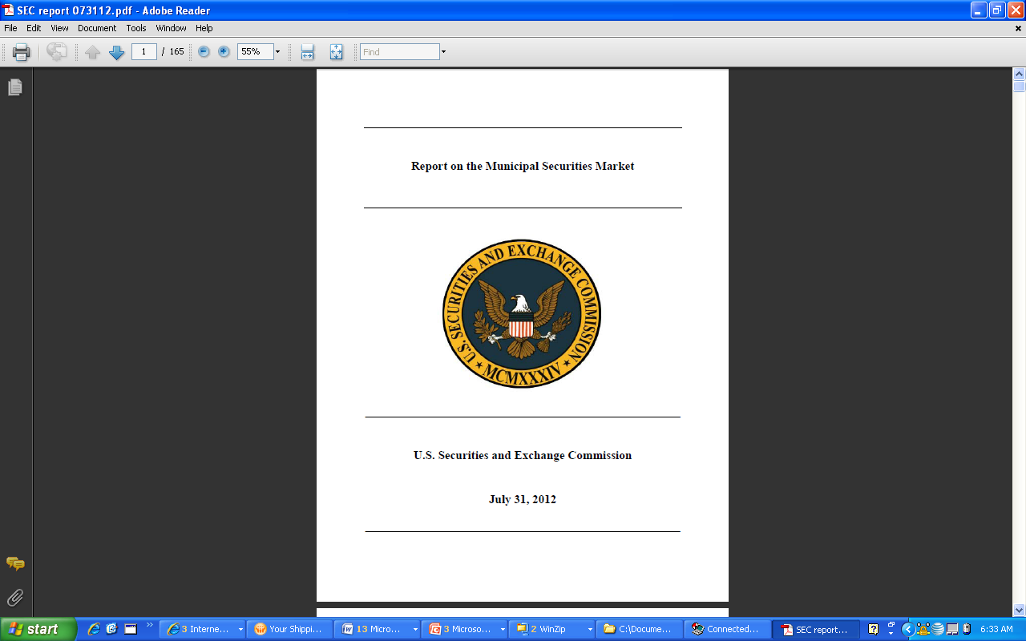
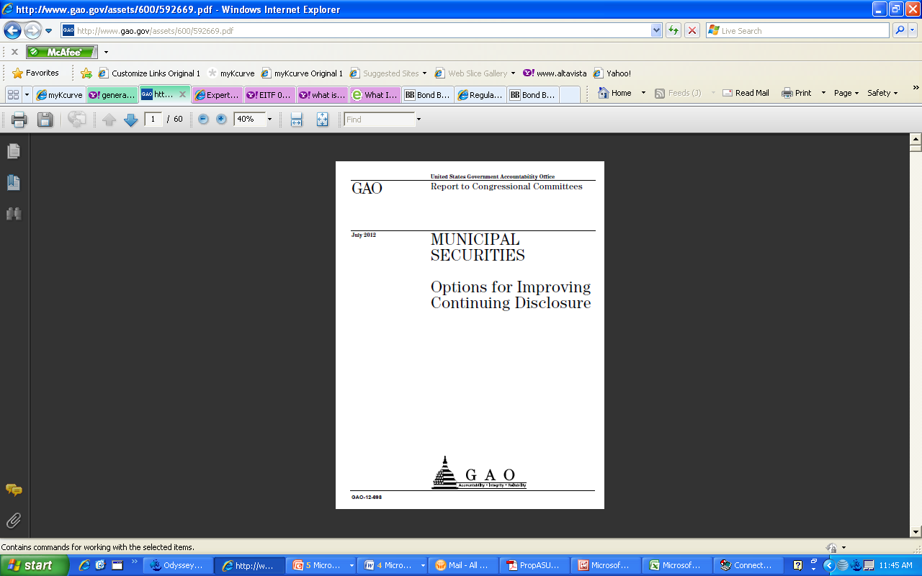
Reports to Congress on muni market regulation – July 2012
104
Notes:
The bottom line of both of these reports is a call for Congress to give the SEC expanded regulatory authority over the muni market.

Slide 105
SEC report
Issued July 31
Based on public hearings held during 2010 - 2011
Goal: ensure that municipal investors have offering documents and periodic reports similar to those for corporate securities.
Expected to lead to a formal request to Congress for authority to regulate municipal securities issuers and conduit obligors
www.sec.gov/news/studies/2012/munireport073112.pdf
Notes:
Report is culmination of more than two years of work presided over by SEC commissioner Elisse Walter, who in May 2010 launched a nationwide inquiry in the muni market with the goal of issuing a final report and recommendations.
The SEC held a series of public hearings around the country, met with dozens of muni market participants and collected written comments from them.

Slide 106
Key disclosure recommendations
Allow SEC to establish baseline disclosure standards for offering documents and periodic reporting
Government financial statements prepared for use by investing public should comply with GASB standards
Audited financial statements required where appropriate
Eliminate exemption for non-municipal conduit bonds
Municipal issuers should establish disclosure controls (policies and procedures)
106
Notes:
I would call it “regulation light.” The SEC would get to say, “these are the minimum elements that should be in an offering document.” The finanial statements should be prepared in accordance with GAAP.
With respect to ongoing financial statements, they wouldn’t tamper with that, but if you have a continuing disclosure coveantn and didn’t file , this would give them …….a regulatory light regulatory regime.
Not clear what is meant by that. SIFMA has come out and said, “we don’t think that would mean that your hc and hgher ed would be ….NFP exclusion ……
Disclosure Controls. The Report states that the SEC “could consider the appropriate disclosure policies and procedures
that municipal issuers should have to assure that they will satisfy their primary and ongoing disclosure obligations.”4
Such statement regarding disclosure policies and procedures echoes prior statements of SEC staff and a recent SEC
enforcement action. In a speech entitled “Lessons Learned from San Diego,” (Dec. 11, 2007), then‐SEC Enforcement Director
Thomsen recommended as one of the “critical lessons” from that enforcement action that cities consider adopting
“written policies and procedures that, at a minimum . . . Clearly state the process by which the disclosure is drafted and reviewed.”
Rule 15c2‐12. The SEC proposed the legislative changes
summarized above, but states in the Report that if the necessary
legislation is not obtained it would consider amending
Rule 15c2‐12 to address various disclosure concerns, including
(i) amending the definition of “final official statement” to include
certain required disclosures (e.g., describe any retail
order period, risks of the offered securities, and disclosures
about the underlying obligor regardless of the existence of
credit enhancement) and (ii) requiring issuers to “have disclosure
policies and procedures in place regarding their disclosure
obligations, including those arising under continuing disclosure
undertakings.”
Conduit Borrowers. The Report recommends that a conduit borrower should not have an exemption from registration
of its securities under the Securities Act of 1933 solely by reason of the conduit issuer being entitled to such an exemption
because it is a municipal entity. Currently, section 3(a)(2) of the Securities Act of 1933 provides a securities exemption for
both the municipal security of the conduit issuer and for the underlying obligation of the conduit borrower, subject to Rule
131.6 Any other exemption available to the conduit borrower (e.g., private placement, non‐profit entities, security guaranteed
by a bank, etc.) would continue to apply.
Financial Statements. The SEC would seek “explicit authority . . . to establish the form and content of financial statements used in municipal securities offerings and establish standards and designate a private‐sector body as the GAAP standard setter for municipal issuer financial statements,” in order to facilitate comparisons between issuers. In recognition of certain states having their own accounting principles, the Report
advises that any such legislative authority would be solely for purposes of the federal securities laws. The SEC would also seek authority to require that municipal issuers have their financial statements audited, whether by an independent auditor or a state auditor.

Slide 107
GAO report
Issued mid-July
Required by Dodd-Frank Act
Compares amount, frequency, and quality of muni secondary market disclosures with those of SEC registrants
Evaluate costs and benefits of requiring muni issuers to provide additional disclosures for benefit of investors
Make recommendations relating to disclosure requirements for muni issuers
www.gao.gov/products/GAO-12-698
Notes:
Independent of the SEC’s efforts, Congress is also considering the need for reform of the municipal market. Dodd-Frank required the Government Accounting Office (GAO) to conduct a study that will:
Compare the amount, frequency, and quality of disclosures provided by issuers of municipal securities with the amount and frequency of disclosures provided by SEC registrants, taking into account the differences between those types of entities;
Evaluate the costs and benefits of requiring issuers of municipal bonds to provide additional financial disclosures for the benefit of investors; and
Make recommendations relating to disclosure requirements for municipal issuers, including the advisability of the repeal or retention of the Tower Amendment.
The GAO report was issued on July 19.

Slide 108
For more information
Remarks on News Conference Call About the SEC’s Report on the Municipal Securities Market (Elisse Walter)
www.sec.gov/news/speech/2012/spch073112ebw.htm
SEC speech: “Regulation of the Municipal Securities Market:
Investors Are Not Second-Class Citizens” (Elisse Walter)
www.sec.gov/news/speech/2009/spch102809ebw.htm
SEC speech: “Lessons Learned from San Diego” (Linda Chatman Thomsen) [Disclosure controls] www.sec.gov/news/speech/2007/spch121107lct.htm
108

Slide 109
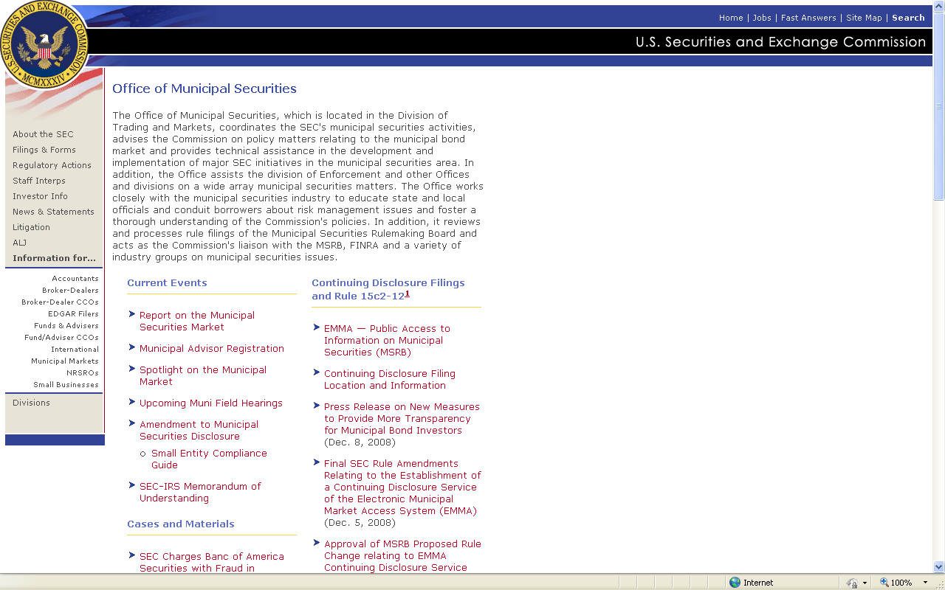
For more information (Continued)
www.sec.gov/info/municipal.shtml
109

Slide 110
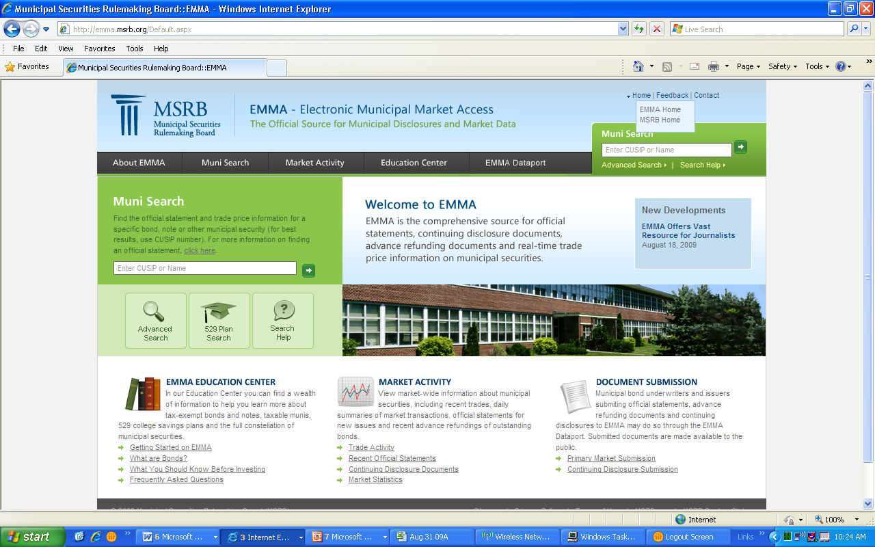
EMMA allows "one-stop shopping" for municipal bond offering documents, periodic disclosure documents, and real-time pricing information
Through EMMA, the investing public can obtain information virtually real-time, free of charge (similar to the level of information available through EDGAR for SEC-registered securities)
www.emma.msrb.org
110

Slide 111
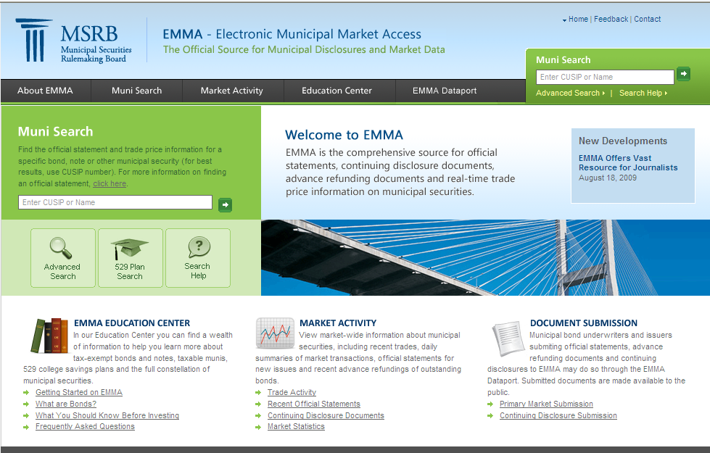

Slide 112
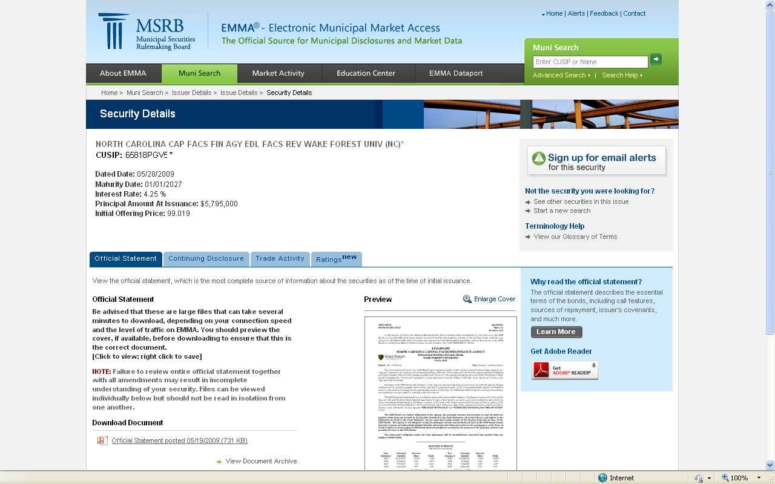

Slide 113
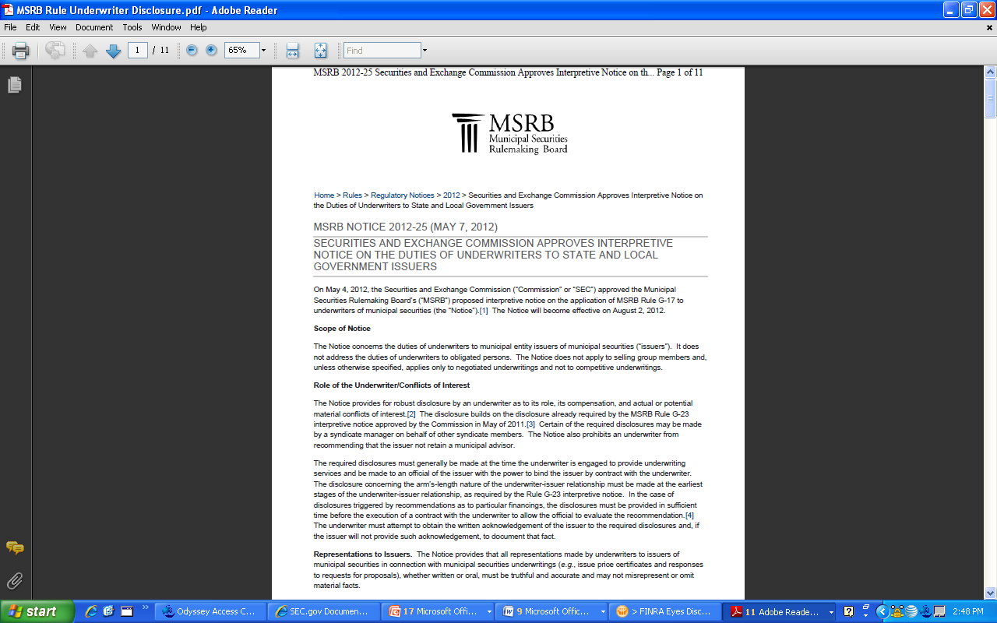
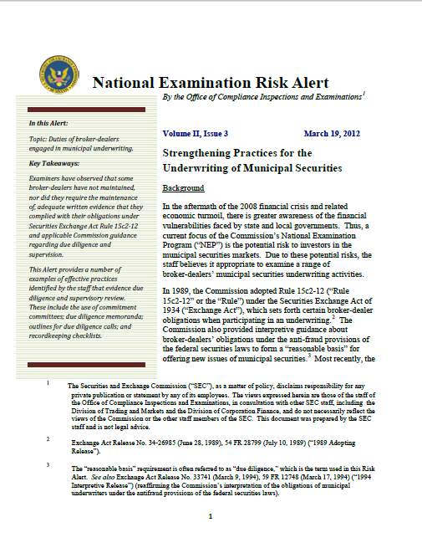
Increased scrutiny of muni underwriter due diligence
www.msrb.org/Rules-and-Interpretations/ Regulatory-Notices/2012/2012-25.aspx
www.sec.gov/about/offices/ocie/riskalert-muniduediligence.pdf
Notes:
In performing examinations of underwriters of muni bond issues, examiners from the SEC office of Compliance and Inspections observed that some are not maintaining adequate written evidence that they complied with their due diligence responsibilities under SEC Rule 15c2-12, Municipal Securities Disclosure, when underwriting a new securities issue. In March they issued a Risk Alert citing their findings and identifying some best practices, including expanded use of due diligence checklists and memoranda.
In May, the MSRB issued a Notice on Duties of Underwriters to Issuers. Requires underwrites to make more disclosures to issuers with respect to matters such as conflicts of interest, the risks associated with the offering, etc. The effective date of those requirements is August.
If you are involved in a municipal bond issue, you may be being asked by the underwriter to sign a lot of different papers that are different from those you have seen in the past. Doing so is being driven by these recent regulatory activities associated with improving documentation of underwriter compliance with due diligence requirements. If you want to read more about this, here’s where to locate the documents.

Slide 114
FRAUD RISK

Slide 115
Types of Audits
Financial statement audits – focuses on looking for misstatements in the financial statements.
OMB Circular A-133 Compliance Audits (or Single Audits) – focuses on compliance with federal programs requirements and internal control over federal expenditures.
Forensic (Fraud) Audits – Focused on identification of fraud. Usually narrowly focuses to specific allegation or suspected fraudulent activity.

Slide 116
Role of Financial Statement Audit
Primarily for an opinion about the fair presentation of the financial statements.
Provide only reasonable assurance that the financial statements are free of material misstatement, regardless of cause, but “reasonable” is defined as a “high” level of assurance.
However, the role shouldn’t be taken for granted, as many analytical relationships among the financial statements, when performed by the auditor, can expose the potential issue.

Slide 117
Financial Statement Audits
Only a small percentage of fraud detected by financial statement audit.
Financial statement audits are not fraud or forensic audits.
Objective is issuing an opinion of financial statements.
The auditor’s report only gives “reasonable assurance” that there are no material misstatements in the financial statements.
Auditors are not required to detect fraud.

Slide 118
Financial Statement Audits (Cont.)
Auditor’s consideration of fraud risk is limited to material misstatements in the financial statements.
Auditor’s obtain an understanding of internal control over financial reporting when planning the audit.
A financial statement audit can provide valuable insight into adequacy of internal controls.
Control weaknesses could be key indicator of a fraud opportunity.
Auditors must exercise professional skepticism during the audit.

Slide 119
AU-C Section 240 – Consideration of Fraud in a Financial Statement Audit
The auditor has a responsibility to plan and perform the audit to obtain reasonable assurance about whether the financial statements are free of material misstatement, whether caused by error or fraud.
  Professional skepticism
  Discussion among engagement personnel
  Identify risks of material misstatement
  Assess the risk
  Respond to the results
  Evaluate audit evidence
  Communicate with management – those charged with governance
  Document consideration of fraud

Slide 120
Government Auditing Standards – Reporting Fraud in a Financial Statement Audit
In an audit performed in accordance with Government Auditing Standards the auditor has additional responsibilities related to reporting fraud above what is required in AU-C 240.
If the auditor concludes that fraud has occurred or is likely to have occurred,
  Include in the report on internal control over financial reporting and on compliance and other matters.
  Information about fraud with material effect on the financial statements that warrant the attention of those charged with governance.
  Information that does not warrant the attention of those charged with governance, the auditor’s determination of whether and how to communicate such instances to auditee officials is a matter of professional judgment.

Slide 121
OMB A-133, Single Audit – Assessing Risk of Material Non-Compliance Due to Fraud
AU-C 240 also applies to a compliance audit
In a Circular A-133 audit , the assessment of fraud risk relates to fraudulent acts that may result in a material noncompliance with a major federal program’s compliance requirements or the misappropriation of federal funds

Slide 122
OMB A-133, Single Audit – Assessing Risk of Material Noncompliance Due to Fraud
(Continued)
As part of the risk assessment process in a single audit, the auditor should:
  Specifically assess the risks of material noncompliance with a major program's compliance requirements occurring due to fraud (fraud risk).
  Consider that assessment in designing the audit procedures to be performed.
  The assessment of fraud risk should be ongoing throughout the audit.
  Use Professional Judgment in adapting AU-C 240 to the objectives of a single audit.

Slide 123
OMB A-133, Single Audit – Assessing Risk of Material Noncompliance Due to Fraud
(Continued)
Suggested single audit risk assessment fraud procedures:
  Conducting a meeting of audit team members to discuss the risks of material noncompliance due to fraud
  Gathering information necessary to assess fraud risk factors for major programs
  Documenting entity-wide programs and controls in place to prevent, detect, and deter fraud
  Inquiring of management, those charged with governance, internal audit, and others about the risks of fraud related to major programs

Slide 124
OMB A-133, Single Audit – Assessing Risk of Material Noncompliance Due to Fraud
(Continued)
Examples of fraud risk factors generally present when material noncompliance due to fraud occurs:
  Incentives or pressures
  Opportunities
  Attitudes or rationalizations
Notes:
Incentives or Pressures
Substantial political pressure on management creates an undue concern about federal award program accomplishments.
Imminent or anticipated adverse changes in program legislation or regulations that could impair the financial stability or profitability of the entity.
High degree of competition for federal awards, especially when accompanied by declining availability of federal awards nationally or regionally.
A stagnant tax or revenue base or declining federal funding, enrollments, or eligible participants.
Complex or frequently revised compliance requirements or participant requirements (such as cost sharing or matching requirements) that create incentives to shift costs or incorrectly value transactions.
A significant portion of program management’s compensation or performance appraisal is linked to federal award budgetary or program accomplishments or other incentives, the value or results of which are contingent upon the entity achieving unduly aggressive targets for budgetary or programmatic results.
Unrealistically aggressive budget or program goals.
A mix of fixed price and cost reimbursable program types that create incentives to shift costs or otherwise manipulate accounting transactions.
Financial pressure due to declining revenues or increasing expenses, creating incentive to apply nonprogram costs to federal awards.
Significant pressure to obtain additional funding necessary to stay viable and maintain levels of service considering the financial or budgetary position of the entity or of specific federal award programs, including need for funds to finance major research and development or capital expenditures.
Threat of imminent program termination or significant reduction in scope, the effect of which could have a material financial impact on the entity.
Opportunities
The nature of the entity’s operations provide opportunities to engage in fraud.
An organizational structure that is unstable or unnecessarily complex
Rapid growth due to significant increases in funds without the organizational structure to support it
Inadequate internal controls due to outdated or ineffective accounting or information systems.
Inadequate oversight by those charged with governance over the financial reporting process and management activities.
Inadequate monitoring by management for compliance with policies, laws, and regulations.
Lack of appropriate segregation of duties or independent checks, especially in areas such as eligibility determination and benefit awards.
Lack of appropriate system of authorization and approval of transactions, such as purchasing, contracting, benefit determinations, and eligibility, due to either poorly designed or outdated controls.
Lack of timely and appropriate documentation for transactions, such as eligibility and benefit determinations.
Lack of asset accountability or safeguarding procedures.
Rapid changes in federal award programs, such as significant centralization or decentralization initiatives, funding shifts from federal to state or local levels, increases or decreases in participant populations, high vulnerability to significant changes in compliance requirements, or pending program elimination.
High turnover rates or employment of accounting, internal audit, or IT staff who are not effective.
Attitudes or Rationalizations
An ineffective or nonexistent means of communicating and supporting the entity’s values or ethics, especially regarding such matters as acceptable business practices, conflicts of interests, and codes of conduct.
Significant subrecipient or subcontract relationships for which there appears to be no clear programmatic or business justification (for example, a subrecipient providing services it does not appear qualified to provide or a vendor geographically distant from the entity when nearby vendors are available).
Management displaying or conveying an attitude of disinterest regarding strict adherence to federal award rules and regulations such as those related to participant eligibility, benefit determinations, or eligibility.
An individual or individuals with no apparent executive position(s) within the entity appearing to exercise substantial influence over its affairs or over individual federal award programs (for example, a major donor, fund-raiser, or politician).
An attitude among program personnel that given their position they, or parties related to them, are due benefits from the program, such as expenses reimbursed by the federal award or participation in the program, to which they would otherwise not be entitled, resulting in questioned costs.

Slide 125
Impact of Fraud on Organizations
The typical organization loses 5% of its annual revenue to fraud translating into a potential total fraud loss of more than $3.5 trillion.
Private Co: 39.3% $200k
Public Co: 28.0% $127k
Govt: 16.8% $81k
NFP: 10.4% $100k
Other: 5.5% $75k
Median months to detection was 18 months

Slide 126

The Fraud Environment
OPPORTUNITY
I’ll take the cash from the deposit, write-off the A/R as bad debt….I can work around the controls
INCENTIVE
How will I pay my bills?
Kids need….
I want ….
Casino night ….
Drugs …
RATIONALIZATION
I deserve a raise...
I work long hours..
I should have been promoted..
I’ll pay it back…
American Institute of CPAs

Slide 127
Types of Controls
Preventive
Detective
Corrective
Manual and Automated

Slide 128
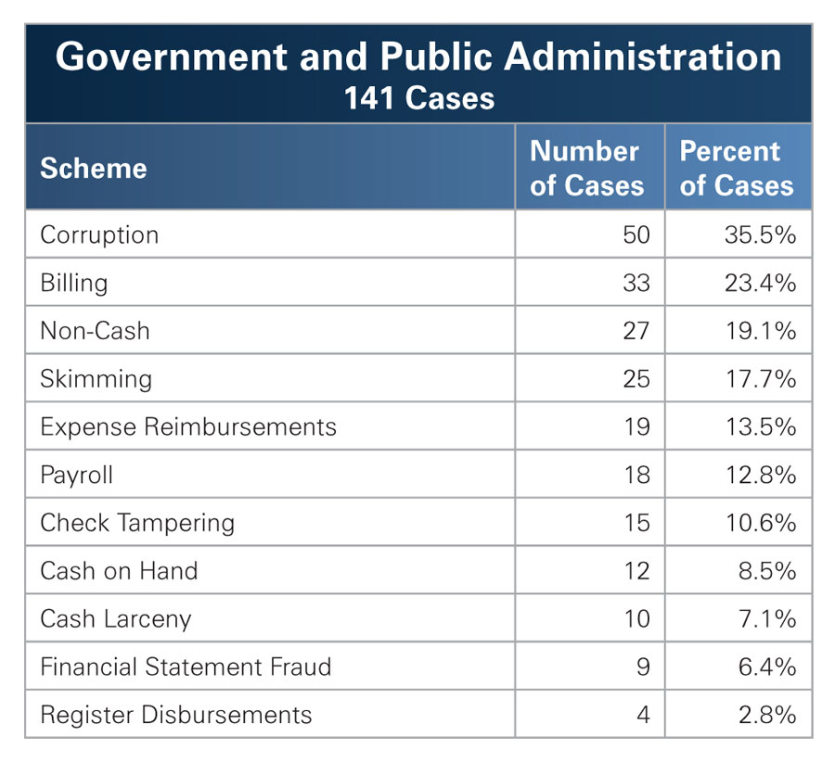
Victim Organizations - Government

Slide 129
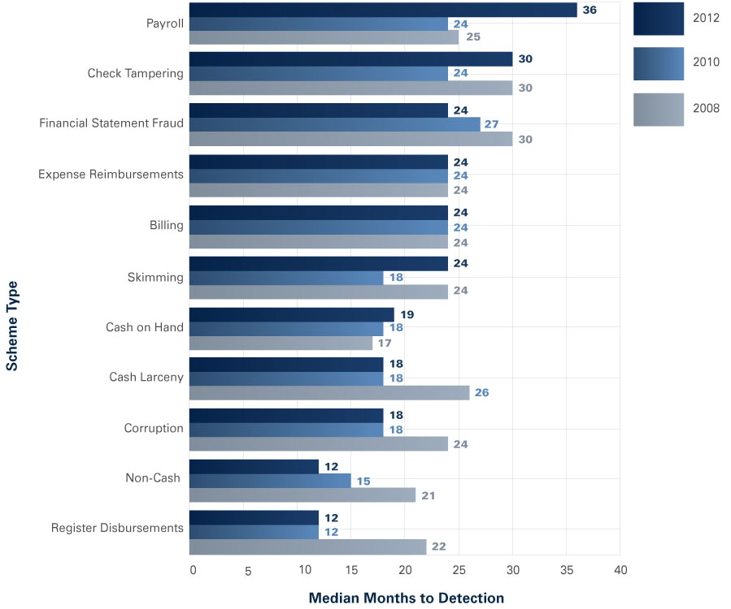
How Occupational Fraud is Committed
Duration of Fraud Based on Scheme Type

Slide 130
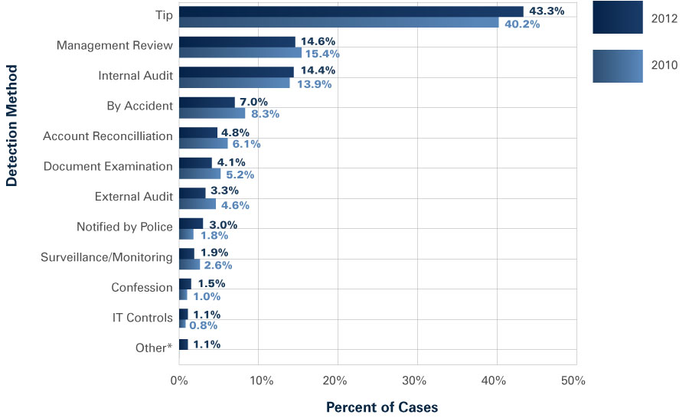
Detection of Fraud Schemes
Initial Detection of Occupational Frauds
Notes:
*“Other” category was not included in the 2010 Report.

Slide 131
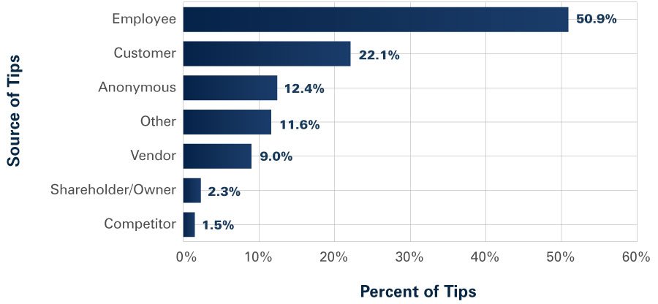
Detection of Fraud Schemes (Cont.)
Source of Tips

Slide 132
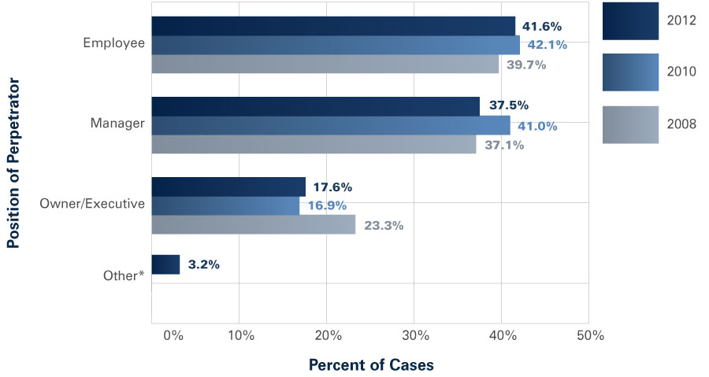
Perpetrators
Position of Perpetrator — Frequency
Notes:
*“Other” category was not included in the prior years’ Reports.

Slide 133
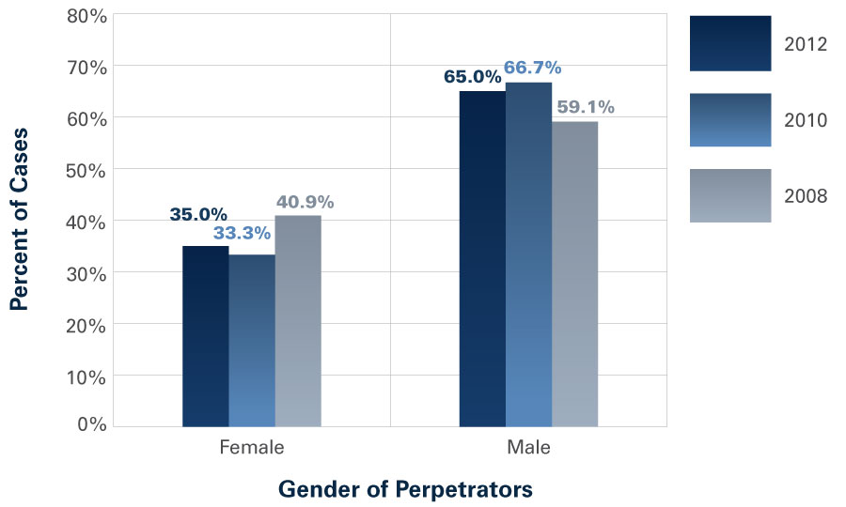
Perpetrator (Continued)
Gender of Perpetrator — Frequency

Slide 134
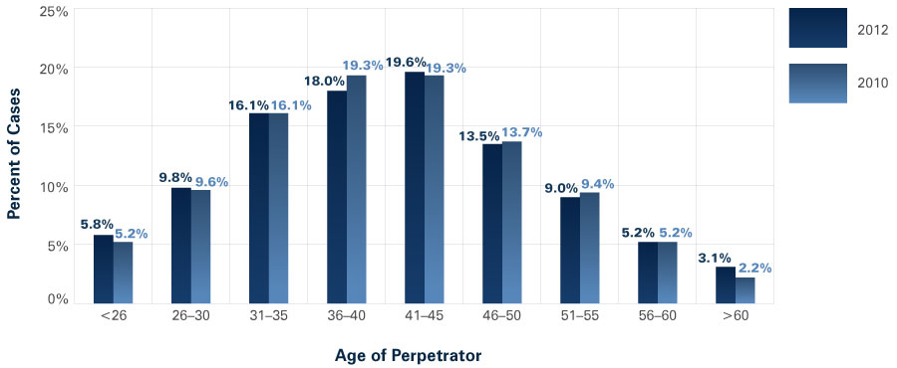
Perpetrators (Continued)
Age of Perpetrator — Frequency

Slide 135
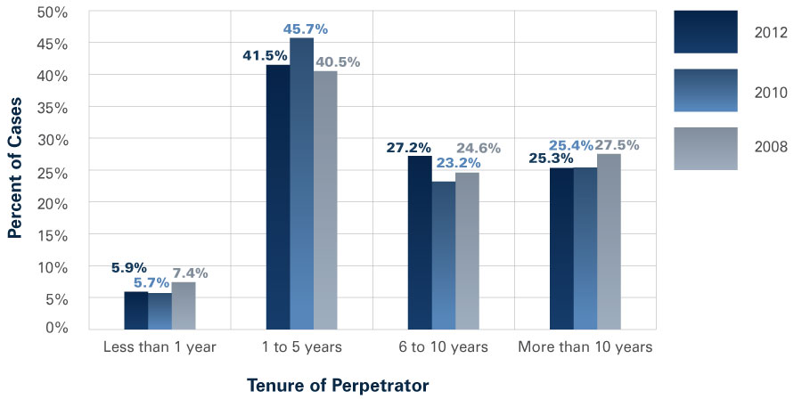
Perpetrators (Continued)
Tenure of Perpetrator — Frequency

Slide 136
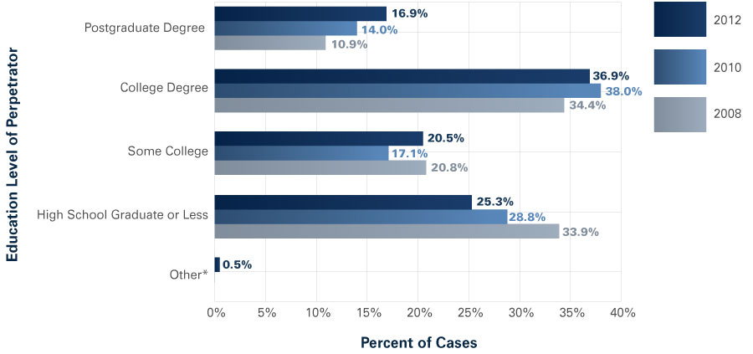
Perpetrators (Continued)
Education of Perpetrator — Frequency
Notes:
*“Other” category was not included in the prior years’ Reports.

Slide 137
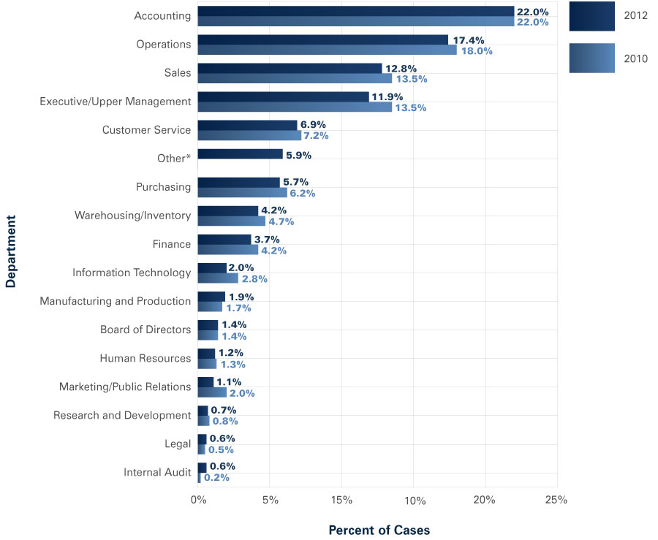
Perpetrators (Continued)
Department of Perpetrator — Frequency
Notes:
*“Other” category was not included in the 2010 Report.

Slide 138
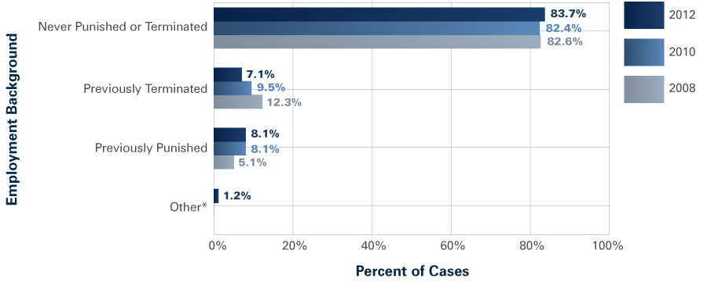
Perpetrators (Continued)
Perpetrator’s Employment Background
Notes:
*“Other” category was not included in the prior years’ Reports.

Slide 139
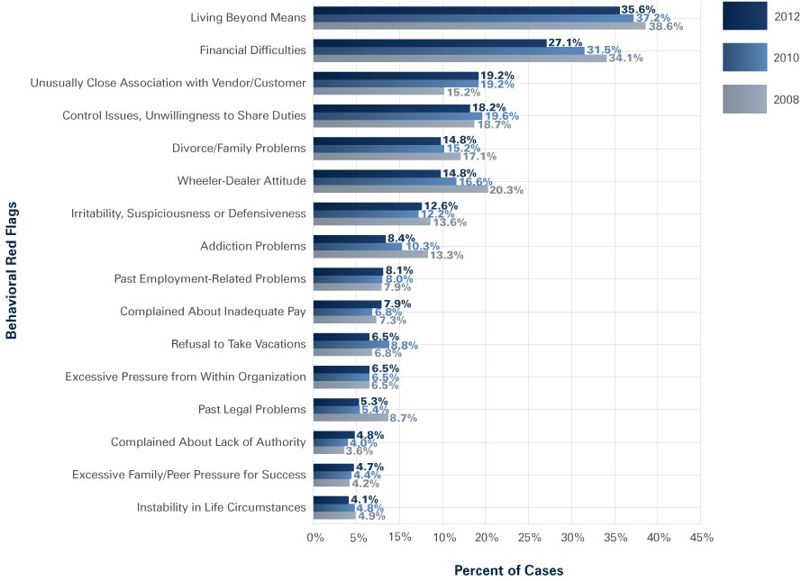
Perpetrators (Continued)
Behavioral Red Flags of Perpetrators
Notes:
Nancy ~ number of federal and/or state exemptions claimed
O’keefe
Crawford

Slide 140
Municipal Bankruptcies

Slide 141
Overview and Recent History
Eligibility Requirements
  Authorization to file
  Negotiation with creditors
Case Administration
  Automatic stay of enforcement claims against the debtor
  Avoidance powers
  Bankruptcy judge
  Collective bargaining agreements
  Official committees

Slide 142
Overview and Recent History (Continued)
Plan of Adjustment Requirements
  Confirmation requirements
  Professional fees
Relationship of State Laws to Federal Laws
  State specifically authorizes Chapter 9 filings
  Chapter 9 is authorized upon conditions met and further action of state, officials or other entity
  Municipalities have limited authorization
  No Chapter 9 authorization outlined

Slide 143
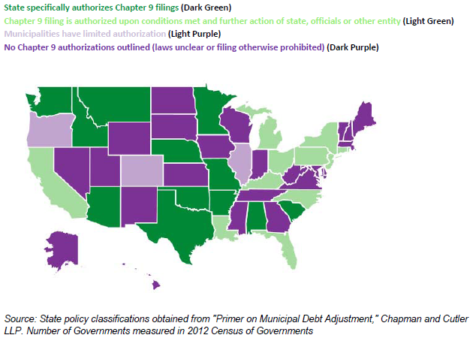

Slide 144
Overview and Recent History (Continued)
Noteworthy Chapter 9 Bankruptcy Cases
  Orange County, California (1994)
  Prichard, Alabama (1999 and 2009)
  City of Vallejo, California (2008)
  Westfall, Pennsylvania (2009)
  Jefferson County, Alabama (2011)
  Harrisburg, Pennsylvania (2011)
  Stockton, California (2012)
  San Bernardino, California (2012)
  City of Detroit (2013)

Slide 145
General-Purpose Local Government Filings (Since January 2010)
Entity | Filing Date | Status
City of Detroit, IL | 07-18-2013 | Open
City of San Bernardino, CA | 08-28-2013 | Open
Town of Mammoth Lakes, CA | 07-03-2012 | Dismissed
City of Stockton, CA | 06-28-2012 | Open
Jefferson County, AL | 11-09-2011 | Open
City of Harrisburg, PA | 03-10-2012 | Dismissed
City of Central Falls, RI | 08-01-2011 | Open
Boise County, ID | 09-08-2011 | Dismissed

Slide 146
Special District Filings (Since January 2010)
Entity | State | Date
Mendocino Coast Health Care District | CA | 10-17-2012
Lost Rivers District Hospital | ID | 03-10-2010
Sanitary and Improvement District #512 of Douglas County | NE | 11-01-2011
Lake Lotawana Community Improvement Districts | MO | 08-27-2010
Hardeman County Hospital District | TX | 03-21-2013
Pauls Valley Hospital District | OK | 03-01-2013
Rural Water District No. 1 Cherokee County | OK | 01-23-2012
Centerton Municipal Property Owners’ Improvement District | AR | 10-12-2011
Sylamore Valley Water Association Public Facilities Board | AR | 04-19-2012
Pulaski County Property Owners’ Improvement District | AR | 07-01-2013
Grimes County MUD#1 and Official Committee of Bondholders | TX | 03-04-2010

Slide 147
Special District Filings (Since January 2010)
(Continued)
Entity | State | Date
Adair County Hospital District | KY | 07-31-2013
Suffolk Regional Off-track Betting Corporation | NY | 05-11-2012
The Southern Connector | SC | 06-24-2010
Barnwell County Hospital District | SC | 10-05-2011

Slide 148
City of San Bernardino, CA
Population 208,000
Status: A federal judge granted the City eligibility for bankruptcy protection on 8/28/2013. The debt or deficit amount was estimated to be $46 million.
San Bernardino City Council voted to file for bankruptcy protection in 2012 after learning the City had only $150,000 left in its bank accounts.

Slide 149
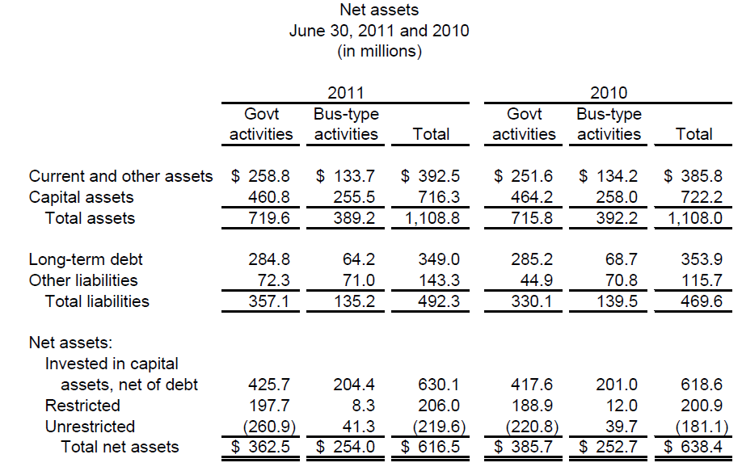
City of San Bernardino, CA (Continued)

Slide 150
City of San Bernardino, CA (Continued)
Negative unassigned fund balance in General Fund of $1.3 million.
Total Governmental Funds had a negative unassigned fund balance of $40 million.
General Fund borrowed $10.2 million from other funds to cover shortfalls in cash.
As of June 30, 2011 the City had an unfunded OPEB liability of $87 million.
Taxable assessed values dropped $1.3 billion since 2009

Slide 151
Town of Mammoth Lakes, CA
Population 8,250
Status: Filed for bankruptcy on 7/3/2012. Debt or deficit estimated to be $43 million.
Mammoth Lakes, a small California resort town, voted to file for bankruptcy after determining it was unable to pay a $43 million legal judgment resulting from a 1997 property development dispute.
Bankruptcy court dismissed the Town’s chapter 9 case finding the Town to be solvent.

Slide 152
Town of Mammoth Lakes, CA (Continued)
The Town entered into a structured settlement agreement with the plaintiff that allowed the Town to make 24 annual payments of $2,000,000, which includes interest of 5% per annum. Total principal and interest payments will be $48.5 million.

Slide 153
City of Stockton, CA
Population 296,000
Status: Filed for bankruptcy on 6/28/2012. Debt or deficit estimated to be $26 million.
Stockton filed for bankruptcy after being unable to reach an agreement with its creditors. The City must pay steep pension and payroll costs while taking in less money from property taxes.

Slide 154
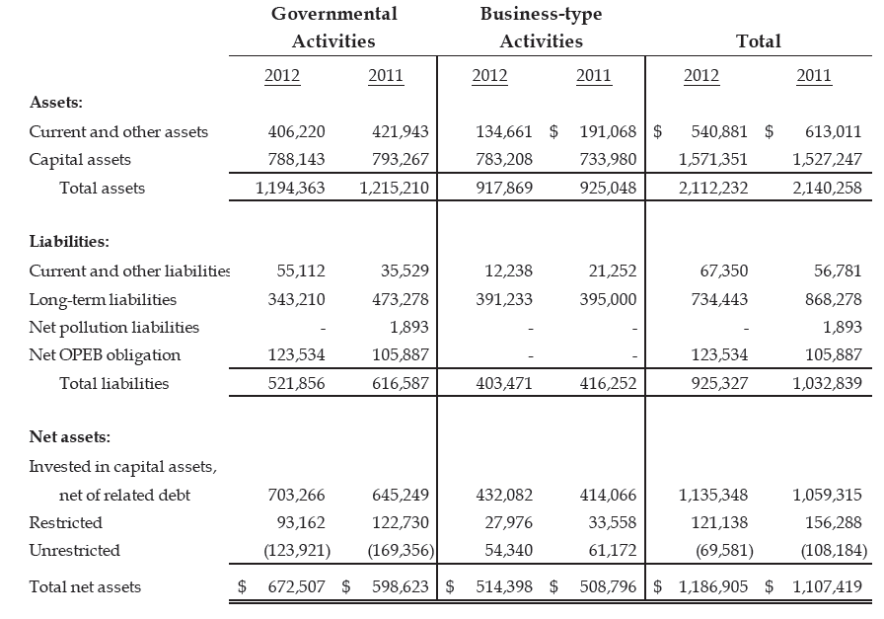
City of Stockton, CA (Continued)

Slide 155
City of Stockton, CA (Continued)
The City has an unfunded OPEB liability of $417 million.
  The City is making changes to on going and future benefits
Property values decreased by $5 billion from 2009 to 2012.
Aggressive home loan program with over $114 million in outstanding loans.
The City defaulted on five major bond issues.
Through referendum, the City adopted a ¾ cent sales tax effective April 1, 2014. The City projects that this will raise an additional $28 million in annual revenue.

Slide 156
Jefferson County, Alabama
Population 660,000
Status: Filed for bankruptcy on 11/9/2011. Debt or deficit estimated to be $4 billion.
The County has laid off about 500 workers since declaring bankruptcy. A federal judge ruled that the bankruptcy was allowed under state law.

Slide 157
Jefferson County, AL (Continued)
Excerpt from the June 30, 2012 Financial Statements. Amounts are in thousands.
Unrestricted Net Assets (Deficit):
  Governmental Activities ($948,404)
  Business-type Activities ($244,683)
Total Net Assets (Deficit) ($558,310)
Occupational and business license taxes deemed unconstitutional according to State Supreme Court. This resulted in a loss of annual revenue of $75 million.
The County has over a Billion dollars in outstanding warrants (bonds). Revenues are not enough to satisfy debt service.

Slide 158
City of Harrisburg, PA
Population 49,000
Status: Bankruptcy filing was rejected. City filed for bankruptcy on 3/31/2012 following defaults on payments due. The debt or deficit was estimated to be $300 million.
Harrisburg skipped about $5 million in debt payments in March 2012. Much of the City’s debt is related to a failed waste-to-energy plant.

Slide 159
City of Harrisburg, PA (Continued)
Excepts from the December 31, 2012 CAFR
Total Governmental Activities Assets $136,167,624
Total Governmental Activities Net Position ($355,767,885)
In 2008 the City had a positive Net Position
Unassigned Deficit of General Fund ($80,393,973)
Total General Fund Balance Deficit ($77,795,886)
Revenues came in under budget by $10,003,775
In 2009 the City had to assume the debt of a component unit in the amount of $264 million.
In 2012 they settled with local municipalities for overcharging utility rates for $11 million.

Slide 160
City of Central Falls, RI
Population 19,000
Status: Filed for bankruptcy on 8/1/2011. Debt or deficit was estimated to be $21 million plus unfunded pension liabilities.
State-appointed receiver Robert Flanders filed for bankruptcy protection and has since cut pensions for retirees.

Slide 161
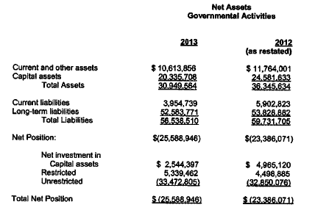
City of Central Falls, RI (Continued)

Slide 162
City of Central Falls, RI (Continued)
The Net Pension Obligation as of June 30, 2013 was $30.4 million.
The Net OPEB Obligation as of June 30, 2013 was $2.7 million.
Unfunded Pension and OPEB liability was $38,804.
To balance their budget the City was not making required payments into the City’s pension trust funds.

Slide 163
Boise County, Idaho
Population 6,800
Status: Bankruptcy filing rejected. Debt or deficit estimated to be $5.4 million.
A federal judgment ordered the rural county to pay $5.4 million in damages and attorney fees to developer Oaas-Laney for allegedly violating the Federal Fair Housing Act. The county later filed for bankruptcy, but failed to prove it was insolvent.

Slide 164
Boise County, ID (Continued)
There was no evidence of insolvency in the County’s financial statements.
Filing for bankruptcy was an attempt to avoid the settlement claim.
The County issued bonds in 2013 to pay the remaining balance of the settlement claim.

Slide 165
City of Detroit, MI
Population 714,000
Status: Filed for bankruptcy on 7/18/2013. Debt or deficit estimated to be $18.5 billion.
Detroit became the largest city in the United States history to file for bankruptcy after Governor Rick Snyder approved a request from City Manager Kevyn Orr.

Slide 166
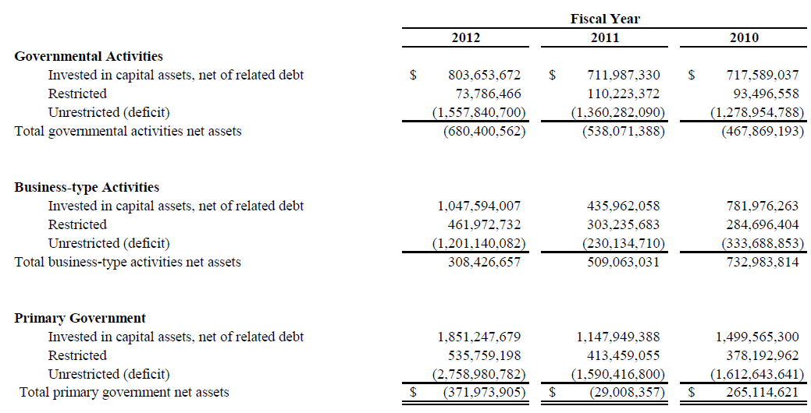
City of Detroit, MI (Continued)
Note – In 2003 Unrestricted balances for GA and BTA were positive.

Slide 167
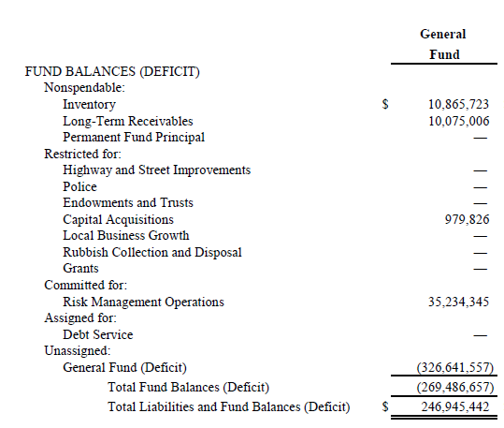
City of Detroit, MI (Continued)

Slide 168
City of Detroit, MI (Continued)
Other financial observations:
  Allowance for uncollectible receivables in the General Fund of $425 million and in Enterprise Funds of $102 million
  Derivative devaluation in Enterprise funds of $140 million
  In 2012 the City began cutting over 2,000 positions City-wide.
  A 10% wage reduction was imposed on Police and Fire uniform personnel and other union employees with expired contracts. Non-union personnel had their wages reduced by 10%.
  Rating agencies downgraded City’s bond issues to junk bond status

Slide 169
The Best Five States in the Country
(Amounts Presented in Millions – Based on 2013 Information)
 | Texas | Tennessee | Oklahoma | Alaska | Wyoming
Population | 26.6 | 6.5 | 3.8 | 0.7 | 0.6
Government-Wide Assets: Governmental Business-Type Total | $ 147,214 91,275 $ 238,489 | $ 34,366 2,251 $ 36,617 | $ 19,195 3,058 $ 22,253 | $ 81,733 2,571 $ 84,304 | $ 19,493 2,286 $ 21,779
GW Unrest. Net Position: Governmental Business-Type Total | $ 11,239 7,466 $ 18,705 | $ 1,458 2,135 $ 3,593 | $ 1,662 603 $ 2,265 | $ 26,271 357 $ 26,628 | $ 4,777 34 $ 4,811
GF Unassigned Fund Bal. | $ 8,028 | $ 476 | $ 144 | $ 16,440 | $ 1,992
Unfunded Pension/OPEB | $ 44,719 | $ 5,011 | $ 310 | $ 89 | $ 1,027

Slide 170
The Worst Five States in the Country
(Amounts Presented in Millions – Based on 2013 Information)
 | California | NY | Illinois | N. Jersey | Mass.
Population | 37.6 | 19.6 | 12.9 | 8.9 | 6.6
Government-Wide Assets: Governmental Business-Type Total | $ 155,837 44,119 $ 199,956 | $ 117,776 25,196 $ 142,972 | $ 43,562 7,619 $ 51,181 | $ 36,146 1,514 $ 37,660 | $ 17,030 9,777 $ 26,807
GW Unrest. Net Position: Governmental Business-Type Total | $ (123,898) (3,347) $ (127,245) | $ (44,380) (3,534) $ (47,914) | $ (66,434) (1,266) $ (67,700) | $ (57,013) ---0-- $ (57,013) | $ (26,734) 1,026 $ (25,708)
GF Unassigned Fund Bal. | $ (23,069) | $ (2,377) | $ (8,172) | $ 301 | $ 1,393
Unfunded Pension/OPEB | $ 171,431 | $ 89,171 | $ 117,395 | $ 98,712 | $ 41,793

Slide 171
Would You Invest in This Company?
BALANCE SHEET
Total Assets | $ 2,968,300
Total Liabilities | (19,877,600)
Retained Deficit | $ (16,909,300)
OPERATING STATEMENT
Total Income | $ 2,851,500
Total Expenses | (3,656,600)
Net Loss | $ (805,100)

Slide 172
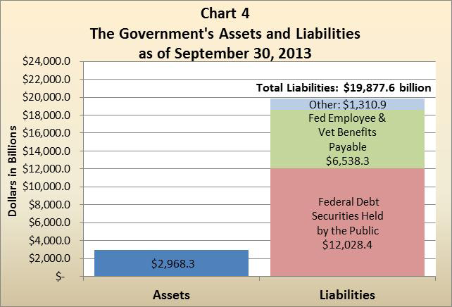
2013 Federal Financial Position(2)

Slide 173
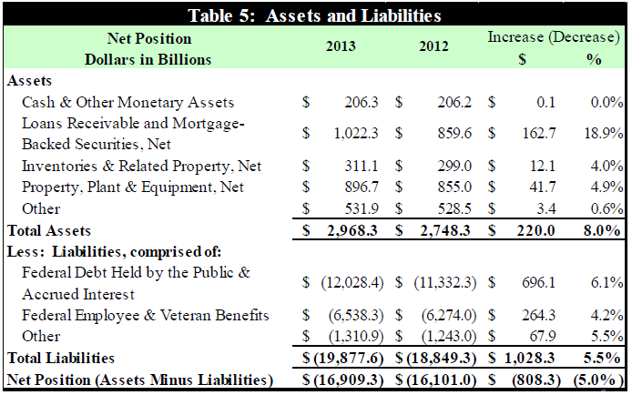
Federal Balance Sheet

Slide 174
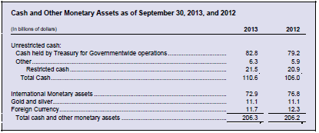
Operating Cash
Approximately 8 days of operating cash on hand.

Slide 175
Questions?

