Slide 1

Volusia/Flagler Chapter
Florida GFOA
Greg Pagans, Vice President
March 20, 2015

Slide 2

Multi-Bank Securities, Inc.
Headquartered: Southfield, Michigan
Fort Lauderdale, FL, office established in 1996
Member of FINRA and SIPC, MSRB Registered
  Member since 1988 (CRD #22098)
  Institutional fixed-income focus
More than 5,000 Institutional Accounts
Approved Underwriter
  U.S. agency securities — FHLB, FHLMC, FNMA
  FDIC-insured bank CDs (MI)

Slide 3
Disclosures
Multi-Bank Securities, Inc. – broker/dealer, not advisor
Offers no regulatory/audit advice
Greg Pagans, Vice President, Institutional Fixed-Income
Registered Representative
— FINRA Series 6, 7, 24 and 63
  (CRD #1585380)

Slide 4
Economic Update
Past, Present, Future
Federal Reserve Bank / FOMC
Domestic Economy
Interest Rates

Slide 5
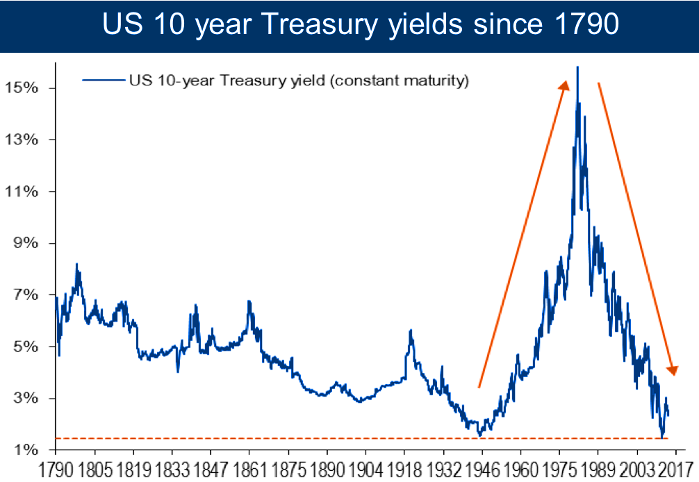
BofA Merrill Lynch Global Investment Strategy, Global Financial Data, Bloomberg

Slide 6
Chairmen and Active Executive Officers of the
Board of Governors of the Federal Reserve System
Paul A. Volcker Aug. 6, 1979 - Aug. 11, 1987
Alan Greenspan Aug. 11, 1987 - Jan. 31, 2006
Ben S. Bernanke Feb. 1, 2006 - Jan. 31, 2014
Janet L. Yellen Feb. 3, 2014 - present

Slide 7
U.S. Federal Reserve and FOMC
“Central Bank” of the United States
Dual Mandate — Price Stability and Full Employment
Controls Short-Term Interest Rates
[Discount and Fed Funds Rates]
Influences Long-Term Interest Rates

Slide 8
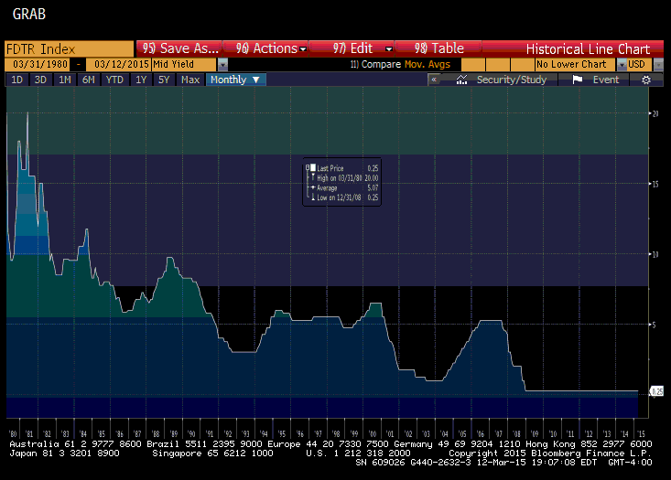
Fed Funds Rate 3/1980 – 2/2015

Slide 9
U-3 U.S. Unemployment Rate Total in Labor Force
The unemployment rate tracks the number of unemployed persons as a percentage of the labor force (the total number of employed plus unemployed). These figures generally come from a household labor force survey.

Slide 10
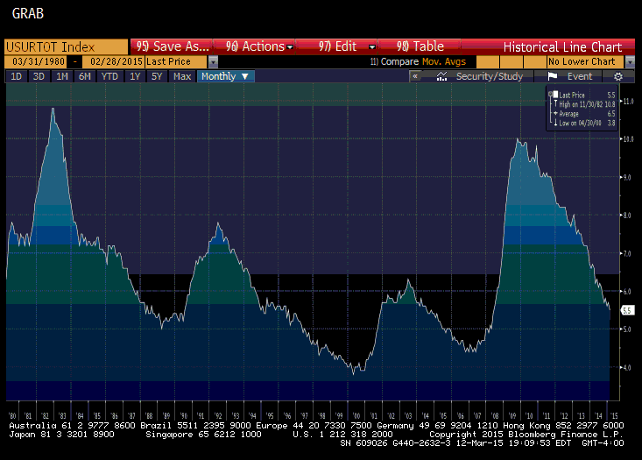
U-3 Unemployment rate 3/1980 – 2/2015

Slide 11
U-6 Unemployment Rate
Unemployed, Margin and Part Time as % of Labor Force
This measure of unemployment includes the total unemployed, plus all persons marginally attached to the labor force, plus total employed part time for economic reasons, as a percentage of the civilian labor force, plus all persons marginally attached to the labor force. (Persons marginally attached to the labor force are those who currently are neither working nor looking for work, but indicate that they want and are available for a job and have looked for work some time in the past 12 months. Persons employed part time for economic reasons are those who want and are available for full-time work, but have had to settle for a part-time schedule).

Slide 12
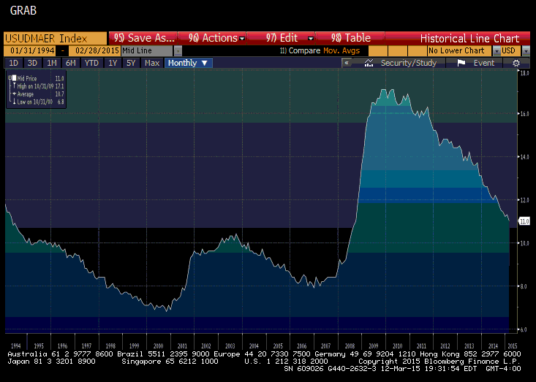
U-6 Unemployment rate 1/1994 – 2/2015

Slide 13
Labor Force Participation Rate 1/1948 – 2/2015

Slide 14
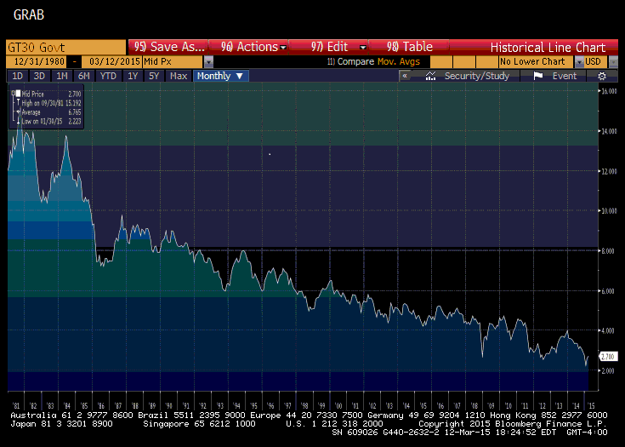
U.S. Treasury 30-Year Bond Yield 12/1980 – 3/2015

Slide 15
U.S. Treasury 10-Year Bond Yield 12/1980 – 3/2015

Slide 16
Yield Curve
A curve on a graph in which the yield of fixed-interest securities is plotted against the length of time they have to run to maturity.
US Treasury definition: Treasury Yield Curve Rates. These rates are commonly referred to as "Constant Maturity Treasury" rates, or CMTs. Yields are interpolated by the Treasury from the daily yield curve. This curve, which relates the yield on a security to its time to maturity is based on the closing market bid yields on actively traded Treasury securities in the over-the-counter market. These market yields are calculated from composites of quotations obtained by the Federal Reserve Bank of New York. The yield values are read from the yield curve at fixed maturities, currently 1, 3 and 6 months and 1, 2, 3, 5, 7, 10, 20 and 30 years. This method provides a yield for a 10 year maturity, for example, even if no outstanding security has exactly 10 years remaining to maturity.

Slide 17
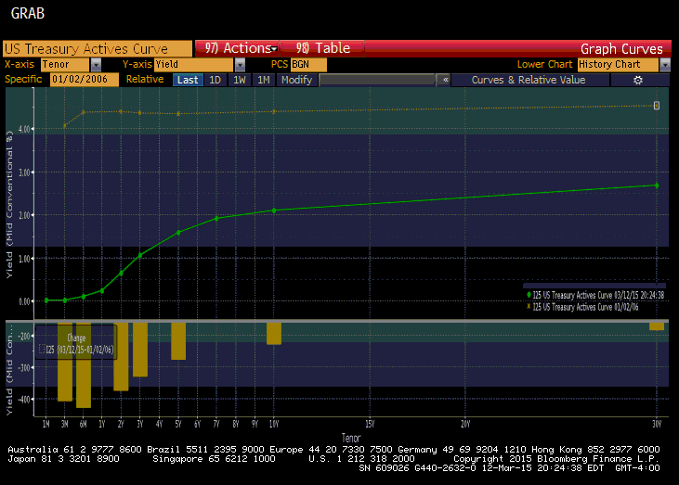
U.S. Treasury Yield Curve 1/2006 and 3/2015

Slide 18
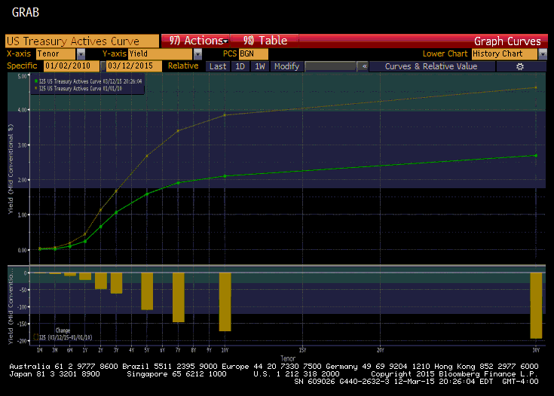
U.S. Treasury Yield Curve 1/2010 and 3/2015

Slide 19
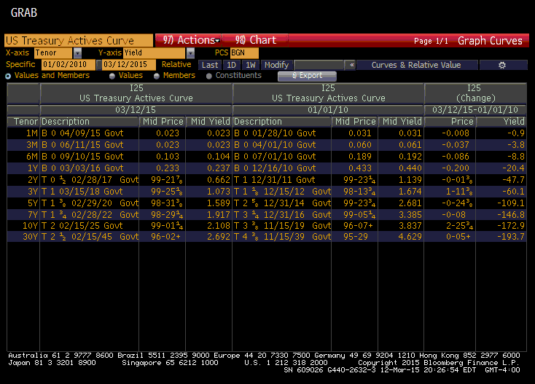
CHANGE in U.S. Treasury Yields Since 1/2010

Slide 20
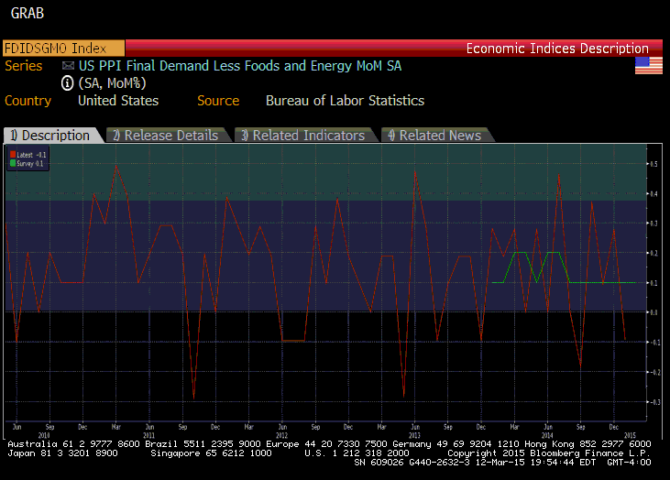
PPI (Producer Price Index) Since June 2010

Slide 21
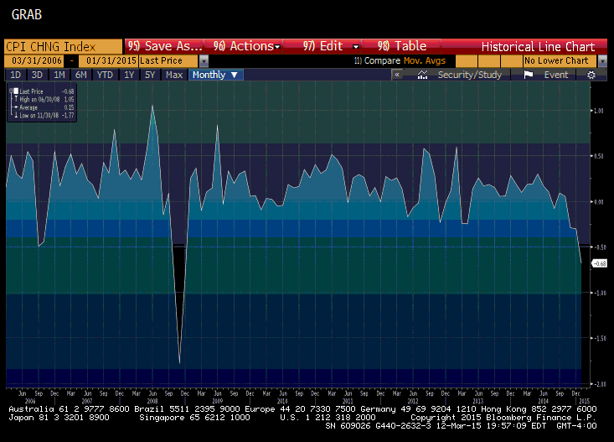
CPI (Consumer Price Index) MoM Since 3/2006

Slide 22
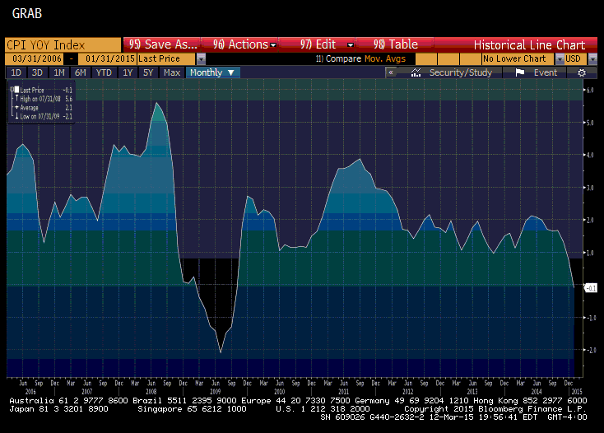
CPI (Consumer Price Index) YoY Since 3/2006

Slide 23
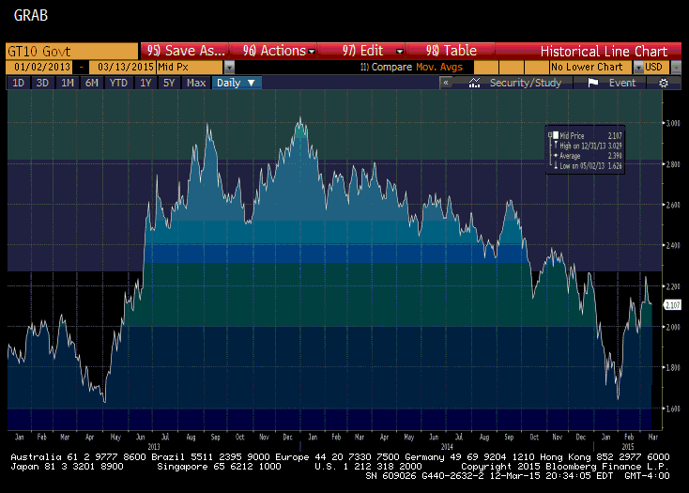
U.S. Treasury 10-Year Yields Since 1/2013

Slide 24
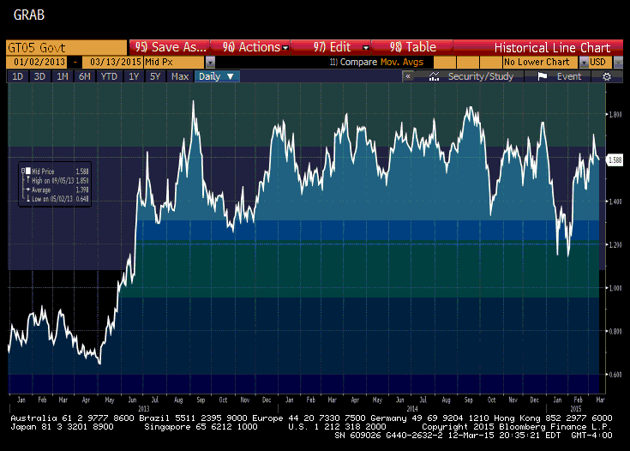
U.S. Treasury 5-Year Yields Since 1/2013

Slide 25
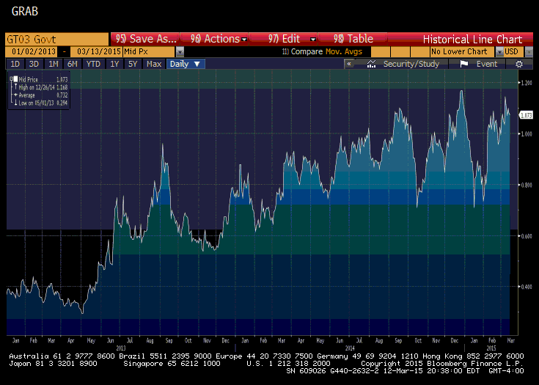
U.S. Treasury 3-Year Yields Since 1/2013

Slide 26
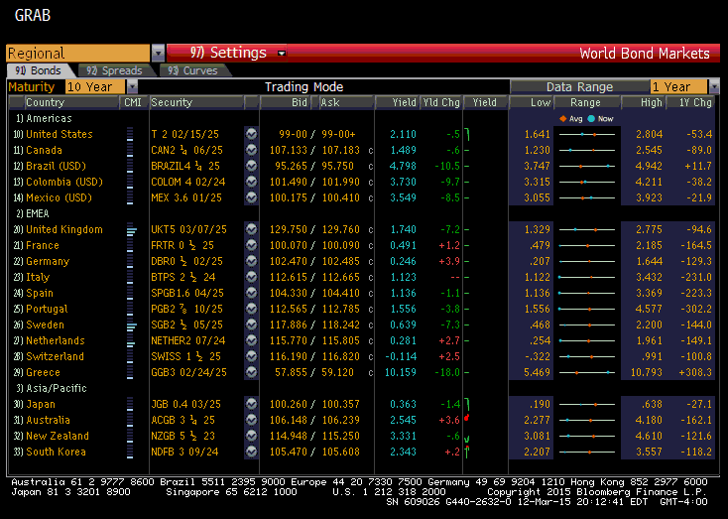
World Interest Rates (Developed Countries)
10-Year Maturities

Slide 27
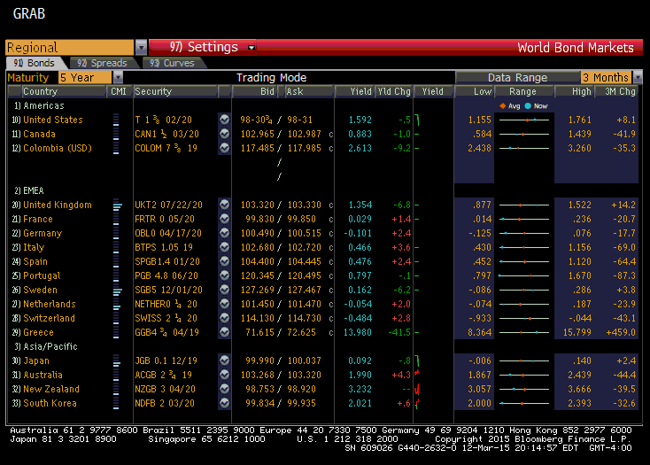
World Interest Rates (Developed Countries)
5-Year Maturities

Slide 28
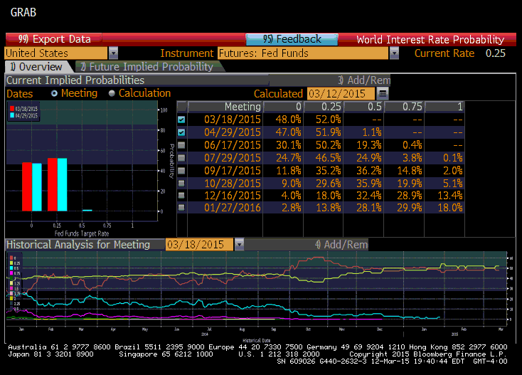
Fed Funds Futures Overview

Slide 29
Resources
Wall Street Journal Online U.S. Treasury Yields
http://online.wsj.com/mdc/public/page/mdc_bonds.html?refresh=on
U.S. Department of the Treasury
http://www.treasury.gov/Pages/default.aspx
Securities Industry & Financial Markets Association SIFMA
http://www.investinginbonds.com/
Board of Governors of the Federal Reserve System
http://www.federalreserve.gov/

Slide 30
Resources
Real Clear Markets (news aggregator)
http://www.realclearmarkets.com/
Business Insider (news aggregator)
http://www.businessinsider.com/
ZeroHedge (news aggregator)
http://www.zerohedge.com/

Slide 31
Thank You!
For additional information, please contact:
Greg Pagans
Vice President, Institutional Fixed Income Registered Representative
FINRA Series 6, 7, 24, 63
(CRD #1585380)
DISCLOSURE:
Multi-Bank Securities, Inc. (MBS) cannot be held responsible for errors regarding time and/or price on buy/sell requests. Information provided in this presentation has been prepared from sources known to be reliable, but is not guaranteed and is not a complete summary or statement of all data necessary for making an investment decision. This is for informational purposes only and does not constitute a recommendation; please confirm all information before investing. Securities discussed are subject to availability and change in price and yield. Changes to assumptions may have a material impact on returns. Past performance is not indicative of future returns. For institutional investors only.
Questions?

